Slide 1
Year 4
History Curriculum

Slide 2
Whole-school definition of history
History is the study of the past, in particular the changes over time that have occurred within human society.

Slide 3
Year 4 Overview
Block 1 | Ancient Greece
Block 3 | Ancient Rome and Roman Britain
Block 5 | The Anglo-Saxons, the Vikings and the Norman Conquest

Slide 4
Block 1
Ancient Greece

Slide 5
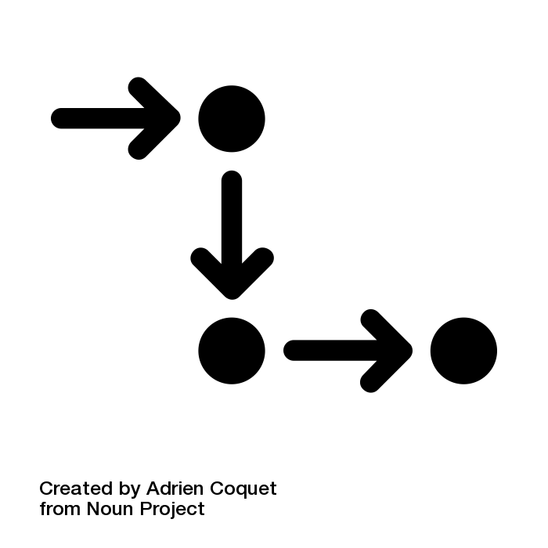

Autumn
Why is ancient Greece considered to be so influential to the modern world?
Key Concept: Cause and consequence, significance
Notes:
A cause is something that makes something else happen - the "why" behind an event.
A consequence is what happens as a result of a cause - the "what happens next" part of the story.
LINK > A cause happens first, and then a consequence follows.
In history, people study cause and consequence to understand how events in the past have shaped the world we live in today.
Significance helps us decide which events, people, or things are more important than others.
When we say that something is significant, we mean that it is really important and has had a big impact on things that have happened after it.
When studying history, it is not possible to remember every single event, person, or thing that ever existed. Instead, we focus on the ones that are most meaningful and have shaped the world we live in today. By understanding significance, we can learn about key moments in the past and how they have influenced the present.
Did it have a big impact at the time it happened?
Did it cause important changes to occur?
Did it influence future events or people?
Significance is all about understanding the importance and impact of something in history.

Slide 6
Neolithic period in Britain
Bronze Age in Britain
Iron Age in Britain
Shang China
Indus Valley civilisation
ancient Sumer
ancient Egypt
ancient Greece
4000 BCE
3000 BCE
2000 BCE
1000 BCE
1000
2000
our school
1100 BCE - The Greek Dark Age (Greek Iron Age) begins
776 BCE - The first Olympic games are held during the Archaic Age
336 BCE - Alexander the Great establishes a Greek empire that reaches as far as Egypt and India
2000 BCE
1500 BCE
1000 BCE
500 BCE
1200 BCE - The Trojan War begins, during the Bronze Period
500 BCE - Democracy is founded in Athens, beginning the Golden Age
146 BCE - Rome conquers Greece, which becomes part of the Roman Empire

Slide 7
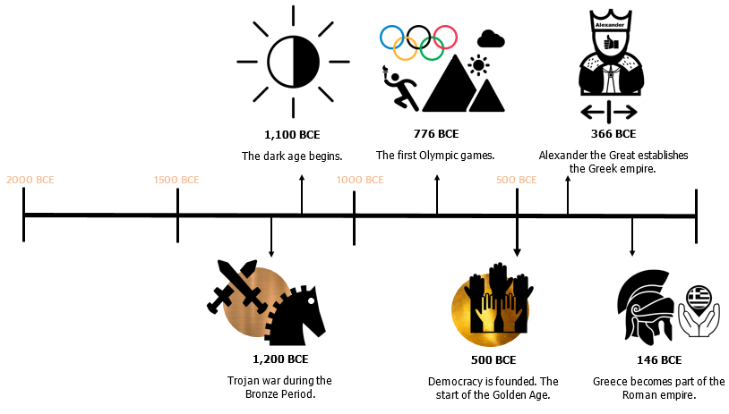
4000 BCE
3000 BCE
2000 BCE
1000 BCE
1000
2000
our school

Slide 8
Year 4 Block 1 Ancient Greece | Retrieval vocab: AD, age, artefact, BC, BCE, CE, century, chariot, epic, event, historian, influence, language, leisure, modern, past, period, rebellion, ruler, territory New vocab: contribution, discipline, employment, empress, experience, flourishing, hero, implement, isolation, journey, limited, luxury, navy, original, reality, seafarer, successor, thinker, tragedy Key concepts: community & culture (architecture, art, civilisation, communication, economy, inspiration, myth, nation, religion, settlement, story, trade), conflict & disaster - (conquest, military, peace, surrender, war), exploration & invention (discovery, migration, navigation, progress), hierarchy & power - (country, democracy, empire, equality, government, law, politics, prejudice, privilege, slavery, tyranny), cause & consequence, change & continuity, similarity & difference, evidence & interpretation (source), significance Overarching enquiry question: Why is ancient Greece considered to be so influential to the modern world?
Week 1 (retrieval) | What have we learned about history so far? Know that history is the study of the past, in particular the changes over time that have occurred within human society Know that time is commonly divided into two periods known as BCE (before common era) and CE (common era); know that these are sometimes replaced with BC (before Christ) and AD (Anno Domini, meaning year of our lord) Know that human prehistory is commonly divided into three periods: the Stone Age, the Bronze Age and the Iron Age Know that the Stone Age lasted for a very long time, most of which was spent as hunter-gatherers without settled homes; towards the very end of this period, humans began living in settlements, undertaking agriculture and raising animals; this created a surplus of food and allowed people to specialise in particular jobs, leading to new technology, architecture and art Know that the Bronze Age and Iron Age followed the Stone Age, during which time people started using using more complicated tools made from these metals Know that the earliest civilisations were ancient Egypt, ancient Sumer, the Indus Valley civilisation and Shang Dynasty China (which began somewhat later); these civilisations were based around fertile river floodplains and involved large groups of people living together with a shared culture and social hierarchy Know that a civilisation is considered by most historians to be a collection of urban areas (i.e. towns and cities) with a settled population doing specialised jobs and trading with one another; written language, artwork and monuments are more common in civilisations Know that historians don’t always agree on what makes a civilisation; saying that a society was uncivilised is often considered as an insult and a way for people in certain places to feel superior to others Know that the maintenance of laws and stability in these ancient civilisations was provided by governments, usually led by powerful rulers, like monarchs (kings , queens, emperors or empresses) Know that the government is a system or group of people with some power over an organised community or country (retrieval from geography)
Notes:
Suggested number of sessions on each point to be added

Slide 9
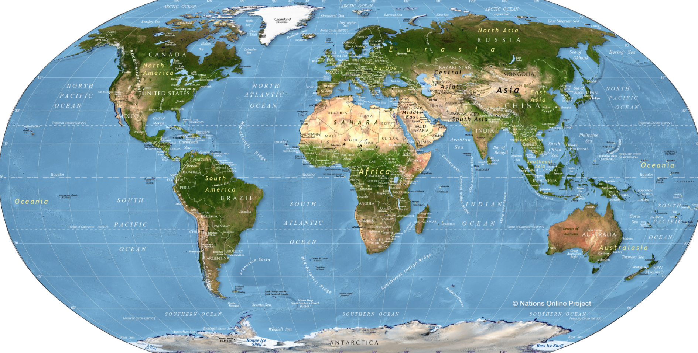
Shang dynasty China
ancient Egypt
ancient Sumer
Indus Valley civilisation

Slide 10
Week 2 | What were the crucial periods in ancient Greece and how did this period begin? Know that some historians argue that ancient Greece was the most influential period in European history in terms of the ideas that were created there Know that ancient Greece is considered by historians to have had four particularly noteworthy periods between 2000 BCE and 146 CE: the Bronze Age, the Archaic Age, the Classical Golden Age and the period in which Alexander the Great made conquests over a large area; as with many ancient historical periods historians disagree upon the exact beginning and end dates of these periods or even whether these periods describe the time well; such periods are always descriptions applied when looking back in time Know that the Bronze Period in Greece spanned from 2000 BCE to 1100 BCE Know that many Greek myths and stories describe events and heroes that are inspired by this period, including the Iliad, the Odyssey and Theseus and the Minotaur Know that after after 1100 BCE, ancient Greece experience a 250-year period of isolation called the Dark Age, also known as the ancient Greek Iron Age Know that the Archaic Period began in 850 BCE when ancient Greece began to trade more with the wider world; this period lasted until around 600 BCE Know that during the Archaic Period, the ancient Greeks invented the alphabet that is used to write many languages to this day, including English; the word alphabet comes from the words “alpha” and “beta”, which are the first two letters of the Greek alphabet Know that Homer created the epic poems the Iliad and the Odyssey during this period; these poems, part of an oral tradition, tell the story of a war with Troy (the Trojan War) and the journey home from this war made by a soldier called Odysseus; in these stories lots of fantastical creatures appear, such as the Cyclops and the Sirens; in these legends the Greek gods play a key role in the story deciding the fates of the characters Know that an epic (e.g. Gilgamesh) is a long set of connected stories of superhuman deeds, usually containing a hero (retrieval) Know that oral tradition is the passing down of what has been said from generation to generation; in particular it relates to aspects of culture that were not written down originally (retrieval) Know how to recognise connections, contrasts and trends over time (retrieval) Know that the ancient Greeks believed in many gods, including Zeus (king of the gods), Athena (goddess of reason, wisdom and war, after whom the city of Athens was named), Hades (god of the dead and the underworld) and Poseidon (god of the sea) Know that belief in many gods is called polytheism Know that the first Olympic games took place in this period; this eventually inspired the modern Olympics, but the original games were a much shorter affair with just a few events; the Olympics were named after Mount Olympus, the highest mountain in Greece, the summit of which was said to be where the Greek Gods lived (see resource below)

Slide 12
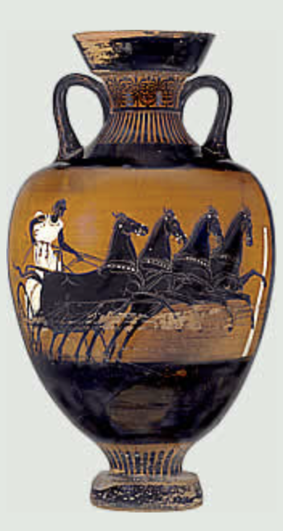
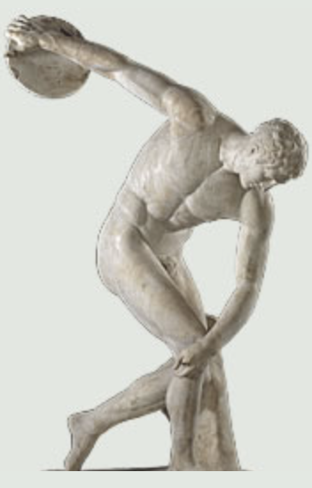
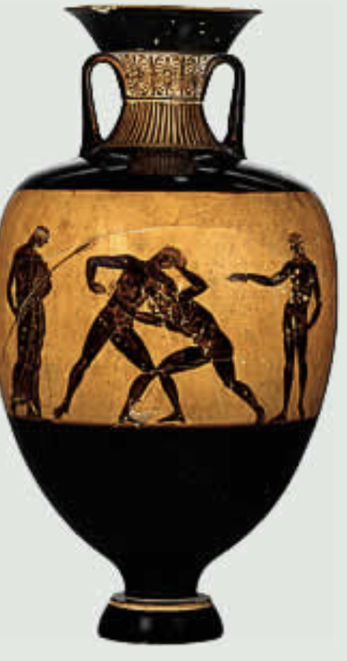
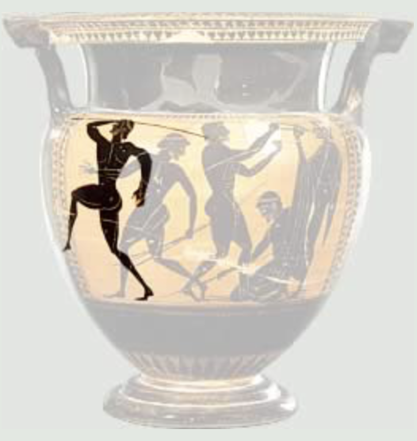
Pottery and a statue showing some of the original Olympic events (chariot racing, discus, wrestling and javelin)

Slide 13
Week 3 | What were the differences between Athens and Sparta, and how much information can we gather from a single artefact? Know that throughout most of its history, ancient Greece was, like ancient Sumer, a collection of independent city-states that shared a language and aspects of culture; Athens and Sparta were two of these city-states, though there were others Know that throughout the times of ancient Greece, trade was essential to the flourishing of these city-states and the development of their economies; the ancient Greeks were a seafaring people, partly because of the need to trade but partly also because of the Greek islands that surround the area Know that Athens and Sparta had different laws, money and rulers; the two cities were rivals Know that democracy is a form of government in which the government is controlled to some extent by the people who live there; it usually requires that people vote to make important decisions Know that Athens was a city-state that for periods implemented the first example of a democracy (demos - people; cracy - rule); however Athens’s democracy was very limited as only adult men; this means that women, children and enslaved people were not permitted to vote Know that a large fraction, probably more than ¼ at points, of the people in ancient Greece were enslaved; these enslaved people were at the bottom of the social hierarchy and had no rights; much of ancient Greece’s economy as built on enslaved people doing work so that others did not have to Know that Athenians valued art and architecture; there were magnificent buildings in Athens such as the Parthenon which was part of the Acropolis, a group of buildings at the highest point in Athens (see resource below); Athenians appreciate leisure and enjoyed luxuries like beautiful vases and going to plays Know that the beautiful architecture of ancient Greece inspired many beautiful buildings elsewhere even into modern times Know that Athens had a powerful navy; a navy is the military of a country that operates at sea, mainly using ships Know that Sparta was a city-state that was not a democracy; it was ruled by two kings at the same time supported by a few other people who made all of the important decisions Know that Spartans valued military strength on land; it wanted its population to be hardened ready for war at all times; boys were taken from their mothers at age 7 to learn the skills of fighting and discipline Know that Spartans valued strength and encouraged people to reject luxuries for a life of discipline Know how to recognise connections, contrasts and trends over time (retrieval) Study the example of Athenian pottery from the British Museum (see the resource linked below) Know that a historical source can provide evidence relating to the events of the past (retrieval) Know that we can devise our own questions about history and begin to answer these using historical sources (retrieval) Know that we can never be sure about the conclusions we draw from historical sources and that we have to let the evidence we have guide us towards the most likely conclusion (retrieval) Know that historians will interpret things in different ways, and will prioritise different ways of looking at history; for example, some will focus on the circumstances that led to events while others will focus on the decisions made by important people; some will focus on military history (the history of battles and wars) while others will focus on the economy (production and trade); it is often sensible to consider different perspectives on history to understand it better (retrieval) Know that artefacts from the past, including examples of writing, tend to be created and owned by those in a position of privilege; because of this we might not get a full picture of the past; for example, precious objects from the past tend to have been the possessions of wealthy people (retrieval) Know how our knowledge of the past is constructed from a range of sources

Slide 14
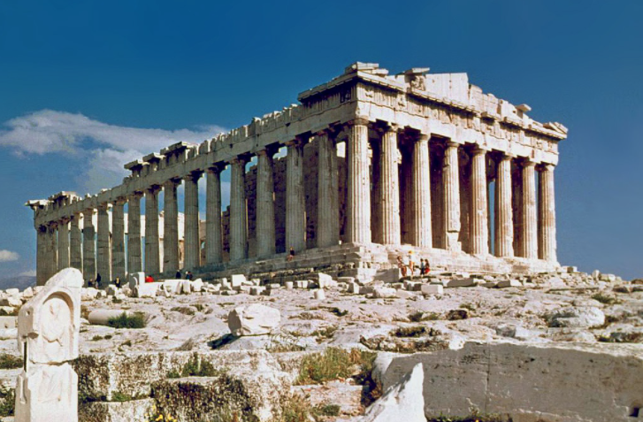
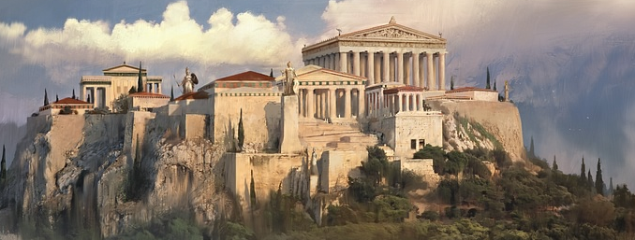
The Parthenon
An artist’s impression of what the Acropolis may have looked like (as what actually remains are mostly ruins)
Life in Athens pottery British Museum enquiry link

Slide 15
Week 4 | What were the most important achievements and advances of the Classical Golden Age? Know that the period between 500 BCE and 400 BCE is called the Classical Golden Age; this is a time of ideas and inventions in Athens that have massively influenced the modern world Know that Athenian democracy - while extremely limited - was the starting point for the democracies that exist around the world today, including the one that exists in the United Kingdom Know that the Athenians watched plays and that they used these as a way to discuss the world and understand it; this included funny plays, called comedies, and plays about things going terribly wrong for a protagonist, called tragedies; all drama from plays to television programmes and films finds its origin in these plays Know that before, during and after the Classical Golden Age, the ancient Greeks made major contributions to mathematics, particularly the study of shape and space Know that Hippocrates lived during the Classical Golden Age and he studied diseases and how they might be cured in a careful way; he is sometimes described as ‘the father of modern medicine’ for this reason Know that Herodotus lived during the Classical Golden Age and he wrote the first record that is an attempt to carefully something that happened in the past; he is sometimes described as ‘the father of history’ for this reason Know that a long war between Athens and Sparta eventually signalled the end of the Classical Golden Age after Athens surrendered

Slide 16
Week 5 | Who were the most important philosophers of ancient Greece, and what does Raphael’s The School of Athens show about how ancient Greece was viewed by some people centuries later? Know that philosophy (philo - love; sophy - wisdom) is the process of thinking deeply about important ideas, such as the nature of existence, right and wrong, how we know things and what makes some things beautiful; philosophy existed before the Classical Golden Age of ancient Greece, but it flowered during this time, particularly due to three thinkers: + Socrates questioned everything, and he encouraged others to do the same; he got in trouble with those in power in Athens for doing this and was sentenced to death by Hemlock poisoning + Plato was Socrates’s student and thought that reality existed in two parts: the things we could experience and the ideal version of things that we could not understand directly; Plato founded his Academy (Akademia), a place where people could study and think; it is from this that word we get the word academy + Aristotle was Plato’s student and disagreed with Plato about the nature of reality: he thought there was no separate reality to the things we experienced; Aristotle was fascinated with studying the real world, especially living things, paving the way for lots of science that was to follow Know that The School of Athens (see resource below) is a painting about people mostly from ancient Greece by an artist who lived much later called Raphael; Raphael lived in Italy during a period called the Renaissance when Greek ideas were being rediscovered; in his painting there are obvious historical inaccuracies, but he is celebrating elements of the past and saying something about what he believes is important (see resource below) Know that figures who did not even visit Athens and who lived much later were included in the painting: + Ptolemy studied the stars and wrote a famous book on stars and planets that people used for centuries afterwards; he believed wrongly that the Earth was stationary and the Sun and stars rotated around it + Euclid studied mathematics and wrote a famous book that people used as the key textbook for teaching mathematics for over 2,000 years Know that sources don’t have to be written records; they can be artefacts of any sort, something made by a person that suggests something about the past (retrieval) Know that we can devise our own questions about history and begin to answer these using historical sources (retrieval) Know that we can never be sure about the conclusions we draw from artefacts and that we have to let the evidence we have guide us towards the most likely conclusion (retrieval) Know that artefacts from the past, including examples of writing, tend to be created and owned by those in a position of privilege; because of this we might not get a full picture of the past; for example, precious objects from the past tend to have been the possessions of wealthy people (retrieval)

Slide 17
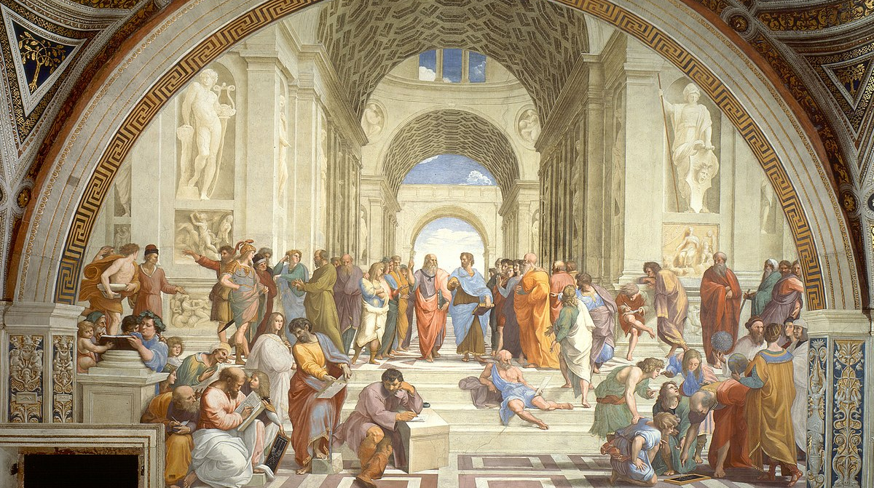
Raphael painted this fresco over a millennium after the people in the painting were alive.
What can we learn about Raphael’s views from this painting?
Why might these figures have been painted onto the same fresco despite - in many cases - living centuries apart?

Slide 18
Plato (pointing to the heavens to suggest his focus on ideal forms and things that we cannot experience)
Aristotle (with his palm flat to the ground to suggest his focus on the real world of our experiences)
Socrates
Ptolemy - lived in Alexandria, Egypt long after Plato and Aristotle
Raphael - the painter of the fresco
Averroes (Ibn Rushd - )
a Muslim scholar born in Spain many centuries after the school of Athens existed
possibly Euclid - lived long after the school of Athens and never lived in Athens
Nb: the architecture isn’t very much like ancient Greece and many people are holding books, despite the fact that the ancient Greeks would have had rolls of papyrus instead)
Nb: Raphael’s painting of great minds is dominated by men; consider what this shows about the past and how our views of equality have thankfully developed
Nb: Raphael adding his own face to this painting suggests that he belongs in this sort of company of great thinkers
Nb: while the painting implies some disagreement between Plato and Aristotle, many historians believe that Raphael is actually discussing the complementary nature of the philosophies of the two thinkers

Slide 19
Week 6 | Who was Alexander the Great, and how did he spread greek ideas and culture? Know that a king called Philip II of Macedon (a part of ancient Greece) conquered most of the city states of ancient Greece Know that Philip II of Macedon employed Aristotle to teach his son, Alexander Know that Alexander succeeded his father and became king, he proved to be an even better military general than his father; Alexander’s armies conquered all of ancient Greece and a massive area outside of it; this area included the locations of the three oldest civilisations learned about in Year 3 (Egypt, Sumer and the Indus Valley)(see resource below) Know how to recognise connections, contrasts and trends over time (retrieval) Know that the ancient Egyptian civilisation ended when an ancient Greek ruler, Alexander the Great, conquered Egypt in 332 BCE (retrieval) Know that Alexander was a cruel and brutal tryant in his conquests; for example, when the ancient Greek city-state of Thebes rebelled against him, Alexander had the entire city burned to the ground and every inhabitant sold into slavery Know that Alexander spent his entire life invading and conquering other territories and died at the age of 33 without naming a successor, and the areas he conquered soon broke apart Know that the conquests of Alexander the Great spread Greek ideas and culture across a wide area which influenced many peoples including the Roman Empire which conquered Greece in 31 BCE; the Roman Empire further spread Greek ideas and culture throughout what is now known as Europe, including to Britain

Slide 20
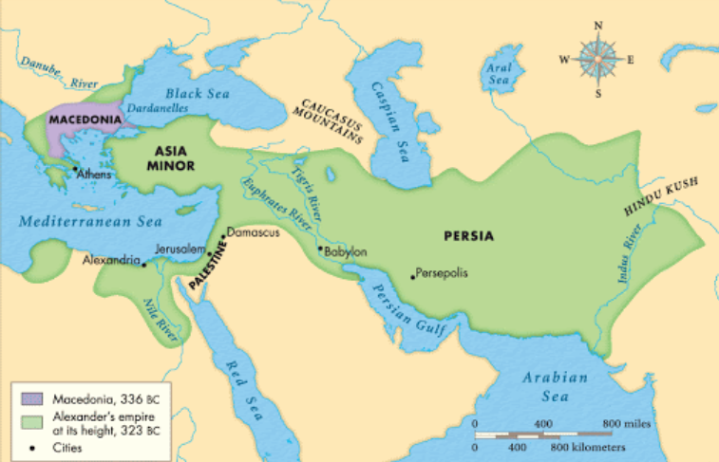
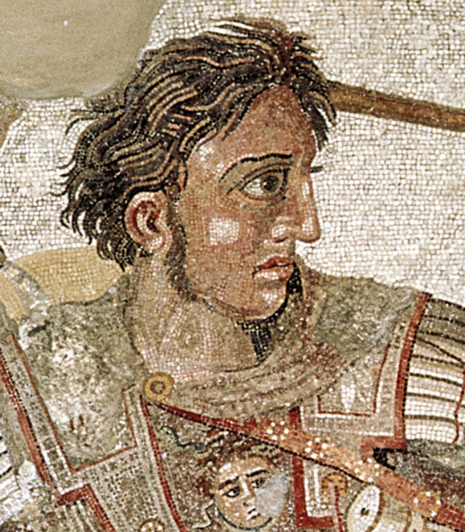
The area conquered by Alexander the Great
A mosaic portraying Alexander the Great

