Slide 1

PE Curriculum
LKS2

Slide 2
Whole-school definition of Physical Education (PE)
Physical Education is the study of developing our physical competence and knowledge of movement and safety, and our ability to use these to perform in a wide range of activities associated with the development of an active and healthy lifestyle. In PE, we are moving to learn and learning to move.
Notes:
‘Learning to move’ i.e. becoming more physically competent and ‘moving to learn’ e.g. learning through movement, a range of skills and understandings beyond physical activity, such as co-operating with others.

Slide 3
Purpose and aims
A high-quality physical education curriculum inspires all pupils to succeed and excel in competitive sport and other physically-demanding activities. It should provide opportunities for pupils to become physically confident in a way which supports their health and fitness. Opportunities to compete in sport and other activities build character and help to embed values such as fairness and respect.
The national curriculum for physical education aims to ensure that all pupils:
develop competence to excel in a broad range of physical activities
are physically active for sustained periods of time
engage in competitive sports and activities
lead healthy, active lives.

Slide 4
Overview- LTP
Year group | Autumn |  | Spring |  | Summer
EYFS | Fairy Tale Dance | First PE | Multiskills | Enjoy a ball | Gymnastics | Athletics
Y1 | Fitness (Pirate) | Winter Dance | Gymnastics | Ball skills 1 | Ball Skills 2 | Athletics
Y2 | Great Fire of London Dance | Gymnastics | Ball Skills 3 | Kwik Cricket (Y1/2) (Striking/Fielding) | Tennis (Y1/2) (Net/Wall) | Athletics
Y3 | Outdoor Adventure/ Orienteering (secure KS1) | Gymnastics | Egyptian Dance | Hockey (Y3/4) (Quicksticks) Invasion | Kwik Cricket (Y3/4) (Striking/Fielding) | Athletics
Y4 | Outdoor Adventure/ Orienteering (KS2) | Gymnastics | Romans Dance | Netball (Y3/4) (Invasion) | Tennis (Y3/4) (Net/Wall) | Rounders (Striking/ Fielding)
Y5 | Multiskills | Fitness | Gymnastics | The Greatest Showman Dance | Kwik Cricket (Y5/6) (Striking/Fielding) | Athletics
Y6 | WW2 Dance (Y5/6) | Hockey (Y5/6) (Quicksticks) Invasion | Netball (Y5/6) (Invasion) | Gymnastics | Tennis (Y5/6) (Net/Wall) | Rounders (Striking/ Fielding)
NB: All children will have swimming for 6 weeks or Forest School in addition to their PE lesson.

Slide 5
Sport | Year Groups Covered | Progression notes
Tennis | Y2, Y4, Y6 | In Y2 teach Y1 & Y2 progression In Y4 recap KS1 & teach Y3 & Y4 Progression In Y6 recap prior learning & teach Y5 & Y6 Progression
Hockey (Quicksticks) | Y3, Y6 | In Y3 teach Y3 & Y4 Progression In Y6 recap Y3/4 and extend into Y5/6
Netball | Y4, Y6 | This builds on KS1 Ball Skills Units In Y4 recap KS1 and teach Y3 & Y4 In Y6 recap prior learning and teach Y5 & Y6
Kwik Cricket | Y2, Y3, Y5 | In Y1 teach recap EYFS and teach Y1 & Y2 progression In Y3 recap prior learning and teach Y3 and Y4 progression In Y5 recap prior learning teach Y5 and Y6 Progression
Outdoor Adventure (Orienteering) | KS2 | Teach KS1 in Y3, Teach KS2 in Y4
Dance | ALL | Follow the year group specific progression points
Gymnastics | EYFS, Y1, Y2, Y3, Y5 | Follow the year group specific progression points
Athletics | EYFS-Y3 & Y5 | Follow the year group specific progression points
Swimming | ALL | Separate lessons for swimming mixing half termly with forest school.
Rounders | Y4, Y6 | In Y4 consider the pre-requisites prior to teaching the KS2 skills.

Slide 6
Key Concepts
Agility Balance, point balance Travelling Levels Perform Strength Shape Beat, Rhythmic/ Rhythm Sequence Vault Canon Unison Tension (body) Choreograph | Score/ point Control Team/ Co-operation Attack Defend Invasion Tactics Coordination Direction , Compass points, Map Space Target Obstacle Dribble Accelerate Pivot Stance
Notes:
Those in red are new concepts introduced Y3.
Those in blue are new concepts introduced Y4

Slide 7
National Curriculum – KS2
Pupils should continue to apply and develop a broader range of skills, learning how to use them in different ways and to link them to make actions and sequences of movement. They should enjoy communicating, collaborating and competing with each other. They should develop an understanding of how to improve in different physical activities and sports and learn how to evaluate and recognise their own success.
Pupils should be taught to:
NC1 use running, jumping, throwing and catching in isolation and in combination
NC2 play competitive games, modified where appropriate [for example, badminton, basketball, cricket, football, hockey, netball, rounders and tennis], and apply basic principles suitable for attacking and defending
NC3 develop flexibility, strength, technique, control and balance [for example, through athletics and gymnastics]
NC4 perform dances using a range of movement patterns
NC5 take part in outdoor and adventurous activity challenges both individually and within a team
NC6 compare their performances with previous ones and demonstrate improvement to achieve their personal best

Slide 8
Quick Navigation
Year 3
Year 4
Progression of Skills in LKS2

Slide 9
Year 3
Notes:
Please follow the weekly planning using Primary PE Planning username and password

Slide 10
Y3 Overview
Autumn | Outdoor Adventure NC5 | Gymnastics NC3, NC6, NC1
Spring | Egyptian Dance NC4, NC6 | Hockey (Quicksticks) NC2
Summer | Kwik Cricket NC2, NC1 | Athletics NC3, NC1

Slide 11
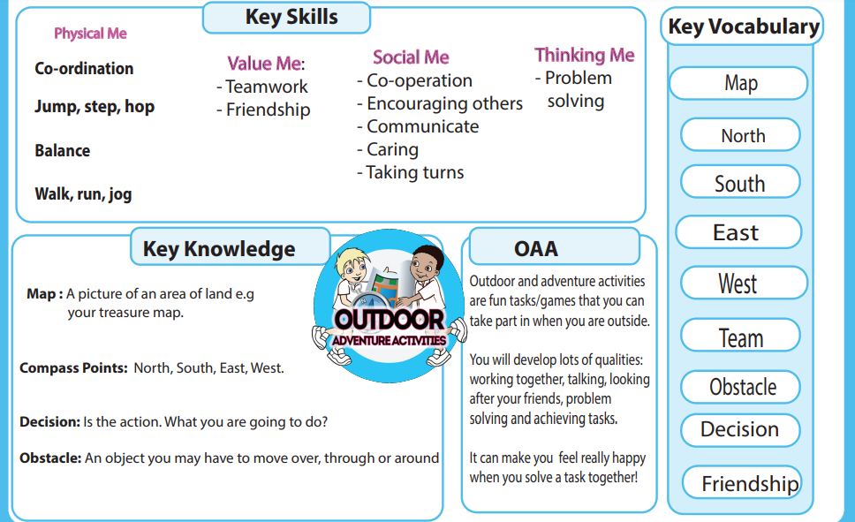
Unit 1:
Outdoor Adventure
Review:
Can master basic movements such as running and begin to apply these in a range of activities
Can demonstrate agility, balance, co-ordination
Can co-operate in physical activities
Can compete against self/others in a range of increasingly challenging situations
Notes:
In this unit, you are teaching the KS1 OAA initially.

Slide 12
Unit learning aims: | To co-operate and encourage my team to cross the river To co-operate with others and create my own obstacle course To use co-ordinates on the map to travel North, South, East and West To use a compass finding land marks using North, South, East and West To work in a group and talk to my friends about the answers To lead my group and also be a team player working together to complete tasks
Week 1 | How can you work with your friends to overcome a challenge?
Week 2 | How can you work with a partner in different challenges?
Week 3 | How can I travel using different directions?
Week 4 | How can you make up your own instructions?
Week 5 | How can you work together to match up the pictures?
Week 6 & Review | How can you work as a team?
Notes:
Weekly plans can be found at: https://primarypeplanning.com/lesson-planning-resources/key-stage-1/ks1-oaa/
Use Year 2 planning

Slide 13
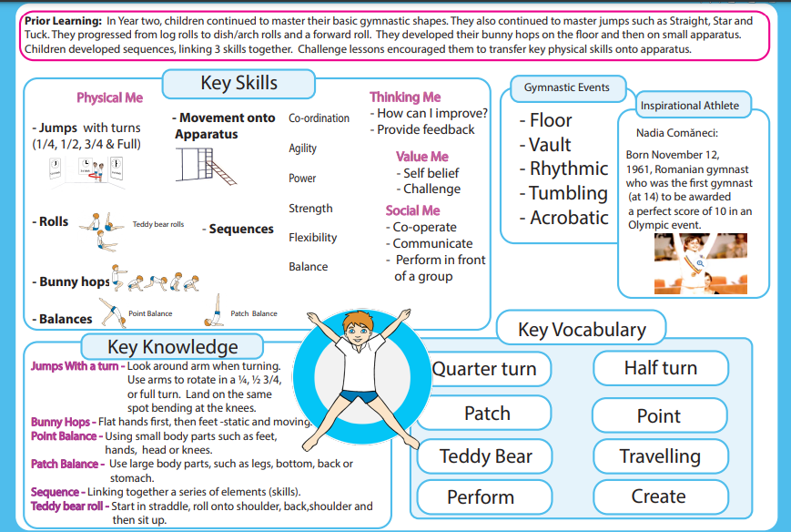
Unit 2: Gymnastics

Slide 14
Unit learning aims: | Can use jumping, in isolation Can begin to use skills in different ways and to link them to make actions and sequences of movement Has begun to develop flexibility, control and balance Is beginning to communicate with others during physical activities Is beginning to compare their performances with previous ones Can begin to recognise their own success Can begin to use running, jumping, in isolation and in combination Can use skills in different ways and to link them to make actions and sequences of movement Has developed flexibility control and balance Can communicate with others during physical activities Can compare their performances with previous ones Can recognise their own success Inspirational Athlete: Nadia Comaneci – watch clips to review and inspire ‘First Perfect 10 Montréal 1976’ NC3 develop flexibility, strength, technique, control and balance
Week 1 | How can you perform a Straight Jump with a turn? To perform a straight jump with 1⁄2 and full turn in a sequence with control, body tension and pointed toes
Week 2 | How can you perform a Teddy Bear Roll? To perform a Teddy Bear roll with control and pointed toes
Week 3 | How can you perform a variety of Point and Patch balances and link them into a sequence? To perform a Point and Patch balance sequence with good body tension, control and fluency
Week 4 | How can you perform a Bunny Hop on apparatus? To bunny hop onto apparatus with control
Notes:
Weekly plans can be found at: https://primarypeplanning.com/lesson-planning-resources/key-stage-2-years-3-4/ks2-gymnastics-2022/
Using Year 3 Lesson Planning
Inspirational Athlete: https://www.youtube.com/watch?v=Yi_5xbd5xdE

Slide 15
Week 5 | How can you perform a sequence on the floor? To perform a sequence using different levels showing good body tension, control and fluency
Week 6 & Review | How can you perform a sequence on apparatus? To perform a sequence on apparatus showing body tension, control and pointed toes To perform a sequence using different levels showing good body tension and control
Notes:
Weekly plans can be found at:

Slide 16
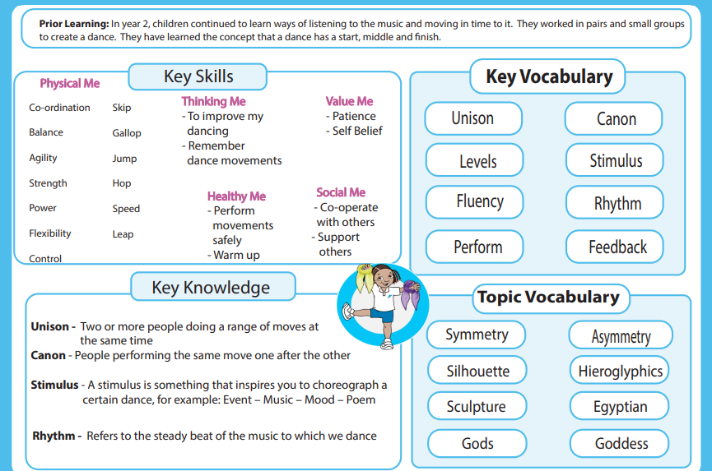
Unit 3: Dance

Slide 17
Unit learning aims: | See italicised items below. NC4 perform dances using a range of movement patterns
Week 1 | How can you use energy and strength when performing a dance? To vary the use of energy and strength when performing
Week 2 | How can you use space when performing a dance? To vary the use of space when performing
Week 3 | How can you use a stimulus to perform a dance? To respond imaginatively to a stimulus and explore movements
Week 4 | How can you collaborate with a group to make a dance performance? To co-operate and collaborate with my group to create a dance performance using a variety of movement patterns
Week 5 | How can you use different levels and directions when performing a dance? To vary the levels and directions when performing
Week 6 & Review | How can you collaborate with a group to make a dance performance? I can co-operate and collaborate with my group to create a dance performance using a variety of movement patterns
Notes:
Weekly plans can be found at: https://primarypeplanning.com/lesson-planning-resources/key-stage-2-years-3-4/egyptian-dance-y3-4/ (Year 3)

Slide 18
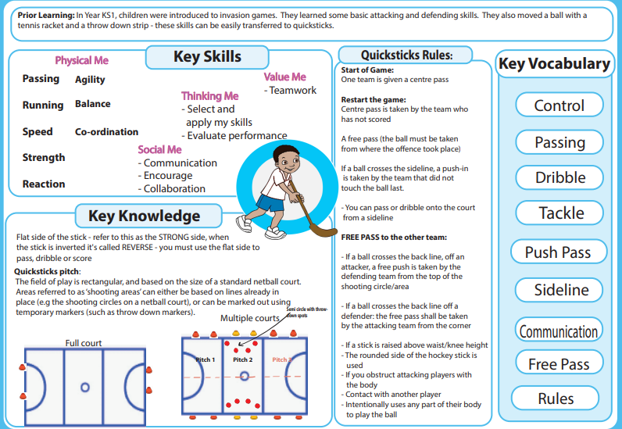
Unit 4: Hockey (Quicksticks)

Slide 19
Unit learning aims: | NC2 play competitive games, modified where appropriate [for example, badminton, basketball, cricket, football, hockey, netball, rounders and tennis], and apply basic principles suitable for attacking and defending See numbered items: 1= Y3 (EXS) and 2= Y4 (Stretch)
Week 1 | How can you dribble a ball? To dribble the ball with control To dribble the ball with good control always looking up
Week 2 | How can you pass and receive a ball over a short distance? To push pass and receive the ball with some accuracy and control To push pass and receive the ball with accuracy and control
Week 3 | How can you pass the ball over a longer distance? To pass the ball over a longer distance with accuracy and power To pass the ball over a longer distance with good accuracy, power and control
Week 4 | How can you pass and receive the ball when moving? To pass and receive the ball with accuracy and control when moving To pass and receive the ball with accuracy and control, choosing the appropriate pass for short and long distances
Notes:
Weekly plans can be found at: https://primarypeplanning.com/lesson-planning-resources/key-stage-2-years-3-4/ks2-y34-quicksticks/

Slide 20
Week 5 | How can you tackle a player safely? To tackle a player keeping my stick on the floor with a wide grip on the stick To tackle a player keeping my stick on the floor; have a wide grip on the stick – keeping low to the ground
Week 6 & Review* | How can you hit a ball to score a goal? To hit a moving ball into a goal with some success To hit a moving ball into a goal with some accuracy and control
+ (Week 7) | How can you work as part of a team when you compete in a small-sided game? To play and embrace the rules, inspiring others with my fair play and I am always gracious in victory and defeat
Notes:
*For time purposes, Week 6 and Week 7 may need to be amalgamated so that pupils can experience a small game to apply their learning. This opportunity must not be missed.

Slide 21
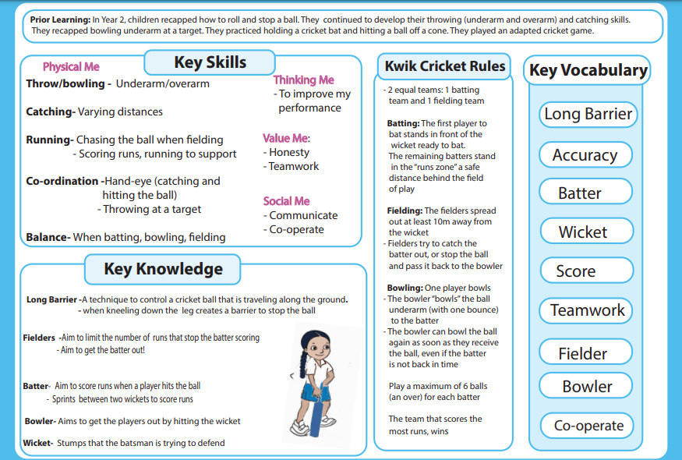
Unit 5: Kwik Cricket

Slide 22
Unit learning aims: | NC1 Can begin to use running, jumping, throwing and catching in isolation and in combination Can use skills in different ways and to link them to make actions and sequences of movement Has developed flexibility control and balance Can communicate with others during physical activities Has begun to play competitive/modified games NC6 Can compare their performances with previous ones NC6 Can recognise their own success See numbered items: 1= Y3 (EXS) and 2= Y4 (Stretch)
Week 1 | How can you roll and stop a ball? To roll the ball with control and accuracy and stop the ball using two hands, one hand and a long barrier To roll the ball over varying distances with control and accuracy, and stop the ball using two hands, one hand and a long barrier
Week 2 | How can you throw underarm, and catch a ball? To throw underarm and catch a ball with control and accuracy To throw underarm over varying distances and catch a ball with control and accuracy
Week 3 | How can you bowl a ball underarm? To bowl underarm towards a target with control and accuracy To bowl underarm with control and accuracy, hitting the wicket with some success
Notes:
Weekly plans can be found at: https://primarypeplanning.com/lesson-planning-resources/key-stage-2-years-3-4/ks2-y34-kwik-cricket/

Slide 23
Week 4 | How can you throw a ball overarm? To throw a ball overarm with control and some accuracy at various heights To throw a ball overarm with control and accuracy at various heights
Week 5 | How can you hit a ball? To hold the bat correctly and hit a moving ball with some control To hold the bat correctly and hit a moving ball with control
Week 6 & Review | How can you take part in a batting and fielding game? To show a variety of the batting and fielding skills I’ve learnt and work as part of a team, encouraging and helping others

Slide 24
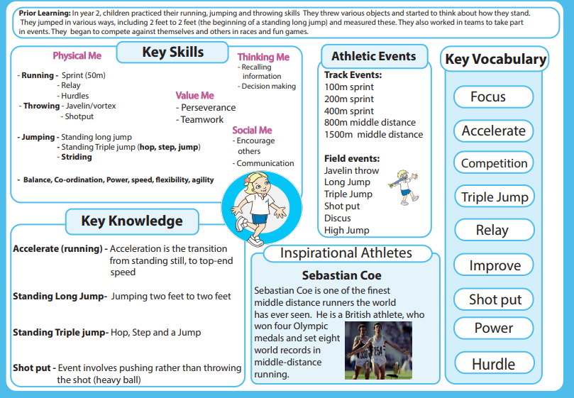
Unit 6: Athletics

Slide 25
Unit learning aims: | See numbered items: 1= Y3 (EXS) and 2= Y4 (Stretch) Inspirations Athlete: Sebastian Coe (watch clips to inspire)
Week 1 | How can you run “FAST”? To pump/swing my arms fast (hip to lip) when running, keep my head still and keep my body trunk upright To react quickly and accelerate over short distances
Week 2 | How can you throw a soft javelin/vortex? To throw a javelin/vortex while standing in the correct stance To throw a javelin/vortex using the correct stance and rotating my hips forward
Week 3 | How can you perform a hop, skip and jump (standing triple jump)? To perform a hop, step and jump with some control To perform a hop, step and jump with control and balance
Week 4 | How can you take off and land over obstacles/hurdles?] To run over an obstacle/hurdle with speed To run over an obstacle/hurdle with speed and control
Notes:
Weekly plans can be found at: https://primarypeplanning.com/lesson-planning-resources/key-stage-2-years-3-4/ks2-athletics-y3-4/ (Year 3)

Slide 26
Week 5 | How can you throw a shot put? To push a tennis ball/netball/basketball while standing in the correct stance To push a tennis ball/netball/basketball using the correct shot put stance and rotating my hips forward
Week 6 & Review | How can you perform a baton changeover in a team relay? To pass a relay baton with control To pass a relay baton with control and timing

Slide 27
Year 4
Notes:
Please follow the weekly planning using Primary PE Planning username and password

Slide 28
Y4 Overview
Autumn | Outdoor Adventure NC5 | Gymnastics NC3, NC6, NC1
Spring | Romans Dance NC4 | Netball NC2, NC1
Summer | Tennis NC2, NC1 | Rounders NC2, NC1

Slide 29
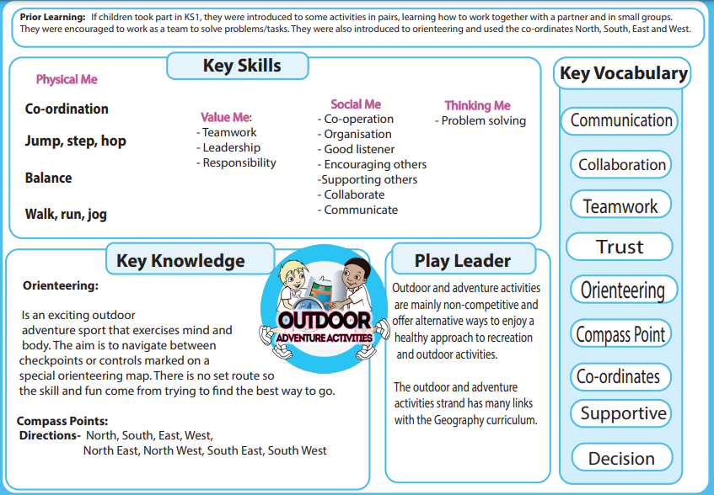
Unit 1: Outdoor Adventure
NB: Children took part in the KS1 units in Y3 to acquire pre-requisite knowledge

Slide 30
Unit learning aims: | NC5 Has taken part in outdoor and adventurous activity challenges both individually and within a team
Week 1 | How can you collaborate with your peers to achieve a task?
Week 2 | How many different ways can you communicate?
Week 3 | How can you set up your own orienteering course?
Week 4 | How can you work as part of a team?
Week 5 | How can you work as part of a team?
Week 6 & Review | How can you trust a partner when blindfolded?
Notes:
Weekly planning can be found at: https://primarypeplanning.com/lesson-planning-resources/key-stage-2-years-5-6/ks2-y56-oaa-2/

Slide 31
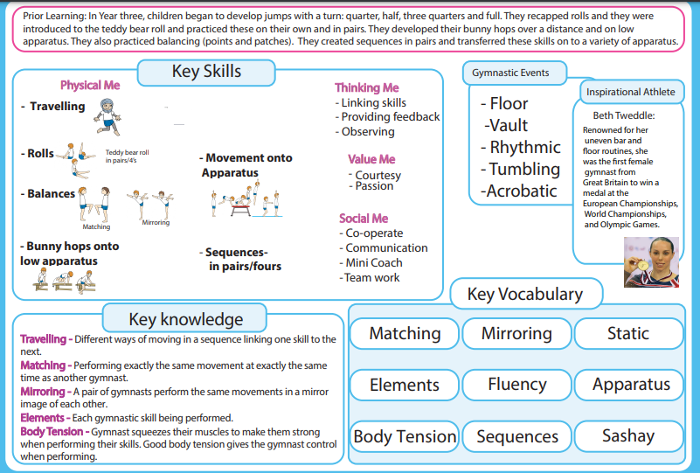
Unit 2:
Gymnastics

Slide 32
Unit learning aims: | NC3 develop flexibility, strength, technique, control and balance (& NC1, NC6) Inspirational Athlete: Beth Tweddle (Watch clips to learn and inspire) See italicised items:
Week 1 | How can you travel in different ways? To travel with fluency, control and pointed toes and linking into my sequence
Week 2 | How can you perform a Teddy Bear Roll with a partner? To perform a Teddy Bear roll on my own/with a partner/group showing precision, control and fluency
Week 3 | How can you perform matching and mirroring balances? To perform complex matching and mirroring balances in a sequence with control, precision and fluency
Week 4 | How can you perform a Bunny Hop on various apparatus? To bunny hop onto apparatus with a short run up showing control, precision and fluency
Week 5 | How can you perform a sequence on mats? To perform a sequence in unison showing good body tension, different levels with good timing, control and fluency
Week 6 & review | How can you choose elements to make a sequence? To create a sequence choosing the more complex optional elements and perform with control
Notes:
Weekly plans can be found at: https://primarypeplanning.com/lesson-planning-resources/key-stage-2-years-3-4/ks2-gymnastics-2022/
Using Year 4 Lesson Planning
Inspirational Athlete: https://www.youtube.com/watch?v=3_VUnVXib-o

Slide 33
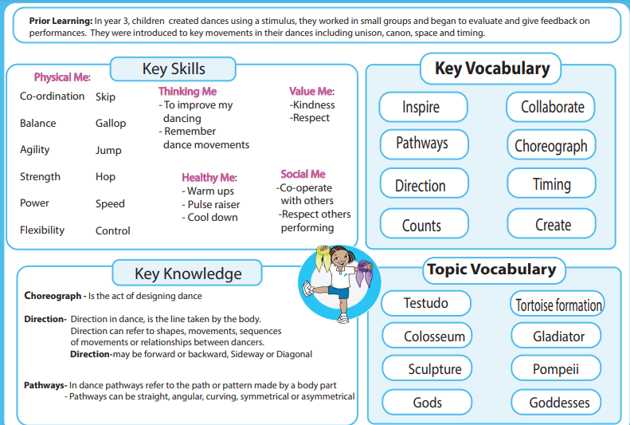
Unit 3:
Dance

Slide 34
Unit learning aims: | NC4 perform dances using a range of movement patterns See italicised items:
Week 1 | How can you use different levels and pathways when performing a dance? To move with control and fluency when showing different levels and pathways when performing
Week 2 | How can you dance in canon when performing a dance? To dance in canon with a group and perform a range of movement patterns, showing good control, fluency and timing
Week 3 | How can you use space when performing a dance? To move with control when showing different uses of space when performing
Week 4 | How can you use a stimulus to perform a dance? To respond imaginatively to a stimulus and explore/show a variety of movements with control
Week 5 | How can you use energy and strength when performing a dance? To move with control when showing different uses of energy and strength when performing
Week 6 & review | How can you collaborate with a group to make a dance performance? To co-operate and collaborate with my group to create a dance performance using a variety of movement patterns * To listen to others and can take on a leadership role.
Notes:
Weekly plans can be found at: https://primarypeplanning.com/lesson-planning-resources/key-stage-2-years-3-4/romans/ (Year 4)

Slide 35
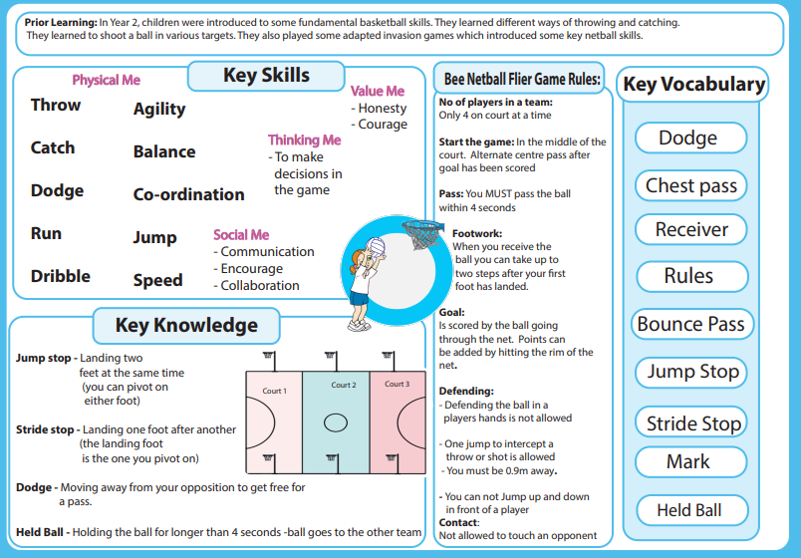
Unit 4:
Netball
NB: KS1 ball skills units as pre-requisite learning

Slide 36
Unit learning aims: | NC2 play competitive games, modified where appropriate [for example, badminton, basketball, cricket, football, hockey, netball, rounders and tennis], and apply basic principles suitable for attacking and defending See italicised items:
Week 1 | How can you pass and receive a ball in netball? To step into the pass keeping my elbows in, and point to where I pass
Week 2 | How can you perform a stride stop in netball? To perform a stride stop and pivot with control
Week 3 | How can you perform a stride and jump stop with a pivot? To perform a stop and pivot with good balance and control
Week 4 | How can you dodge in netball? To use a variety of dodges to get into a space
Week 5 | How can you mark a player? To mark my partner standing side on to them and keep on the balls of my feet
Week 6 | How can you shoot in netball? To place my hand under the ball and support it with the other when I shoot
Week 7 | How can you work as part of a team when you compete in a High – 5 netball match or small-sided game? To play and embrace the rules, inspiring others with my fair play and I am always gracious in victory and defeat
Notes:
Weekly plans can be found at: https://primarypeplanning.com/lesson-planning-resources/key-stage-2-years-3-4/ks2-y34-netball/
NB: Week 2 & 3 to be amalgamated if unable to do 7 sessions.

Slide 37
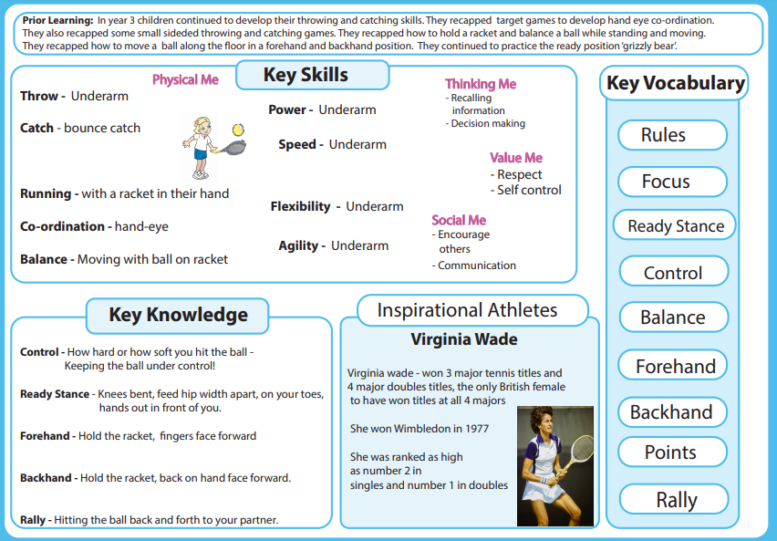
Unit 5:
Tennis

Slide 38
Unit learning aims: | NC2 play competitive games, modified where appropriate [for example, badminton, basketball, cricket, football, hockey, netball, rounders and tennis], and apply basic principles suitable for attacking and defending See italicised items: Inspirational Athlete: Virginia Wade
Week 1 | How can you move when catching a ball? To move in a variety of directions with balance and control when catching a ball
Week 2 | How can you control a ball with a racket when moving? To control a ball on my racket when moving To hit/bounce a ball when moving
Week 3 | How can you hit the ball using a forehand? To hit a ball using a forehand with control and some accuracy
Week 4 | How can you hit the ball using a backhand? To hit a ball using a backhand with control and some accuracy
Week 5 | How can you hit a ball with accuracy? To hit a ball into a target with no bounces before hit To hit a ball to a target from a variety of distances with no bounce
Week 6 | How can you play a 1v1 game of tennis? To rally in mini tennis with some control and accuracy
Notes:
Weekly plans can be found at: https://primarypeplanning.com/lesson-planning-resources/key-stage-2-years-3-4/ks2-y34-tennis/

Slide 39
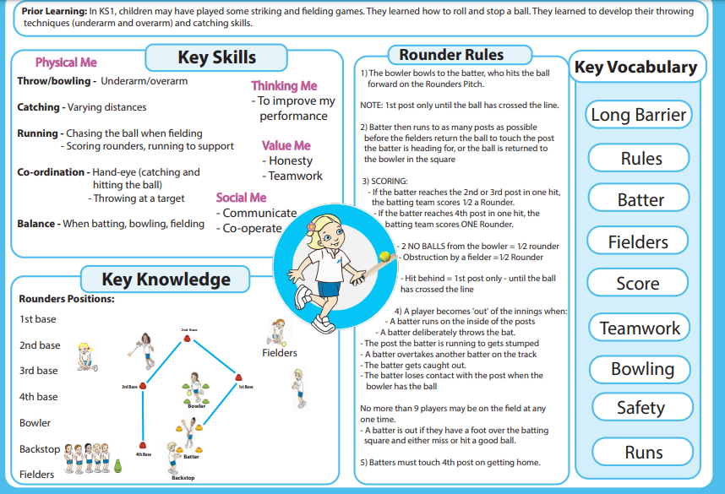
Unit 6:
Rounders

Slide 40
Unit learning aims: | NC2 play competitive games, modified where appropriate [for example, badminton, basketball, cricket, football, hockey, netball, rounders and tennis], and apply basic principles suitable for attacking and defending See italicised items:
Week 1 | How can you throw a ball using underarm and overarm? To throw under/over arm over varying distances and catch a ball with control and accuracy
Week 2 | How can you bowl a ball in rounders? To consistently bowl a good ball (between the batters knee and head) from a short distance
Week 3 | How can you hit a ball in rounders? To bat a ball and begin to try and place it in a space
Week 4 | How can you field a ball in rounders using long barrier? To perform a long barrier moving into position to scoop up the ball To perform a long barrier in a game situation moving towards the ball
Week 5 & 6 (review) | How can you take part in a batting and fielding in a rounders game? To show a variety of the batting and fielding skills I’ve learnt and work as part of a team
Notes:
Weekly plans can be found at: https://primarypeplanning.com/lesson-planning-resources/key-stage-2-years-3-4/rounders/

Slide 41
Progression of Skills at LKS2

Slide 42
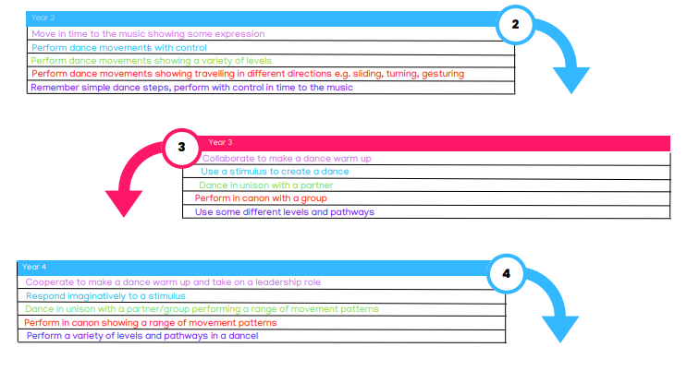
Progression in Dance at LKS2

Slide 43
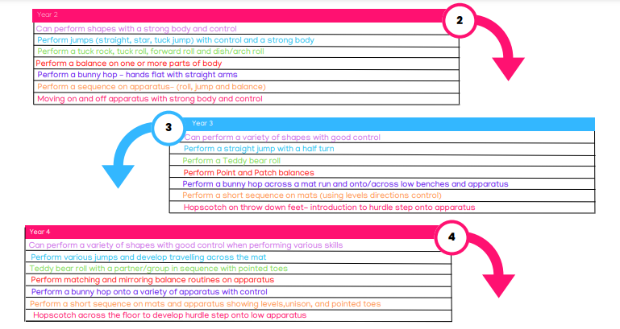
Progression in Gymnastics at LKS2

Slide 44
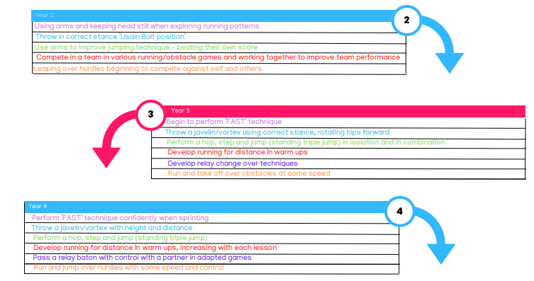
Progression in Athletics at LKS2

Slide 45
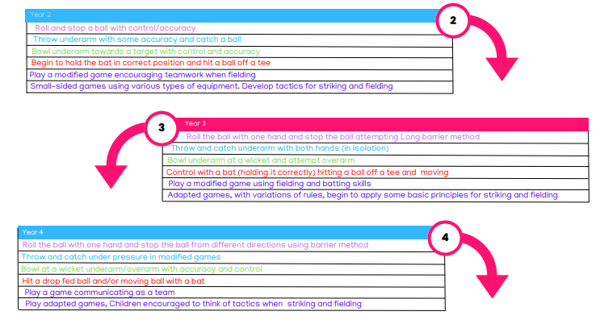
Progression in Kwik Cricket at LKS2

Slide 46
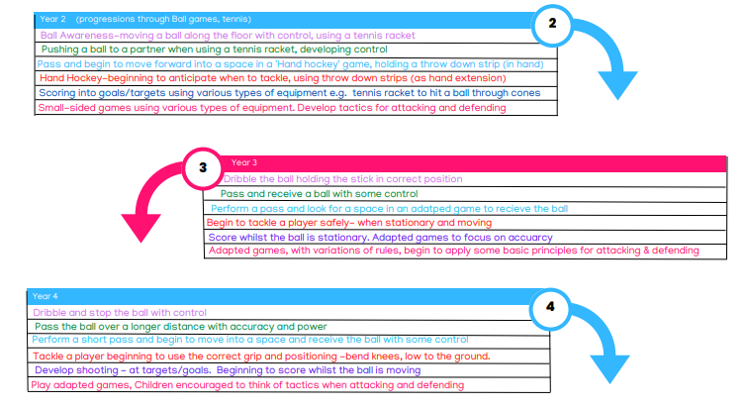
Progression in Hockey

Slide 47
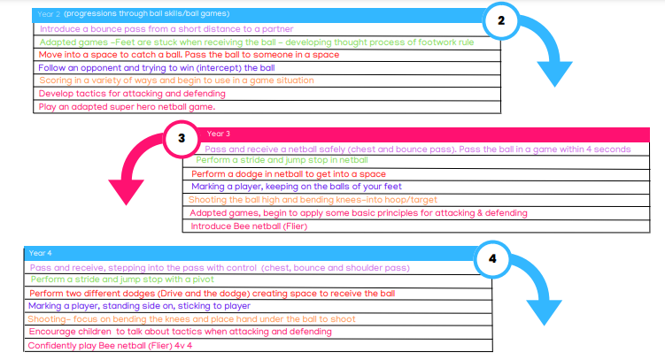
Progression in Netball

Slide 48
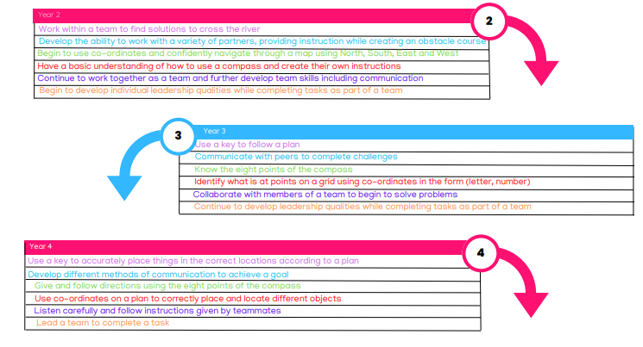
Progression in OAA

Slide 49
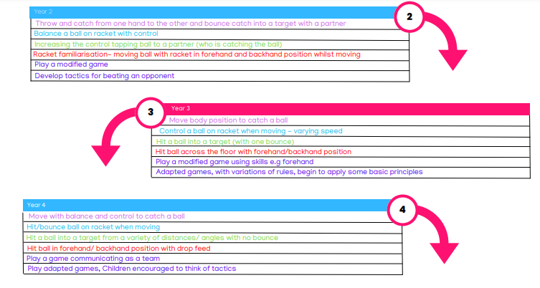
Progression in Tennis

Slide 50
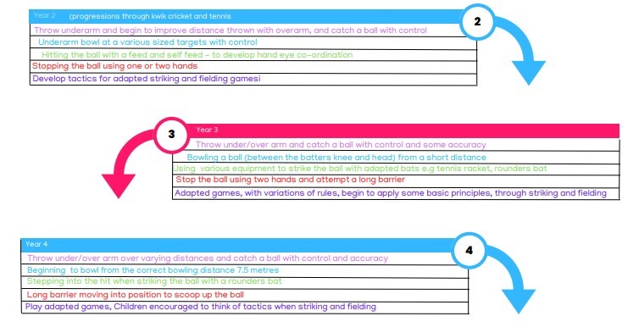
Progression in Rounders

