Slide 1
Year 4
Science Curriculum

Slide 2
Whole-school definition of science
Science is a way to understand our world by carefully thinking about it and testing our guesses with observations and experiments.

Slide 3
Year 4 Overview
Block 1 | Biology: Animals Including Humans
Block 2 | Physics: Sound
Block 3 | Physics: Electricity
Block 4 | Chemistry: Solids, Liquids and Gases
Block 5 | Biology: Living Things and Their Habitats
Block 6
Notes:
Suggested number of sessions on each point to be added

Slide 4
Year 4 Working Scientifically
(Continuing from year 3) Revision properties, observe, test, magnifying glass, object, record, equipment Know that we can ask questions about the world and that when we observe the world to answer these questions, this is science Know that we can use magnifying glasses to observe objects closely Know that we can test our questions to see if they are true Know that objects can be identified or sorted into groups based on their observable properties Know that we can write down numbers and words or draw pictures to record what we find New learning and vocabulary prediction, measurement, enquiry, dependent variable, independent variable, fair test, similar, theory, hypothesis Know that we can ask questions and answer them by setting up scientific enquiries Know how to make relevant predictions that will be tested in a scientific enquiry Know that in a fair test one thing is altered (independent variable) and one thing that may change as a result is measured (dependent variable) while all other conditions are kept the same Know how to use a range of equipment to measure accurately, including thermometers, data loggers, rulers and stopwatches Know how to draw bar charts; how to label a diagram using lines to connect information to the diagram; how to use a coloured key how to draw a neat table; how to draw a classification key; how to show the relationship between an independent variable in a two-way table; and how to label specific results in a two-way table Know – with structured guidance - how to write a simple scientific enquiry write-up including an introduction, a list of equipment, a numbered method, a detailing of results and a conclusion Know how to precis a scientific enquiry write-up into a brief oral discussion of what was found in a scientific enquiry Know that scientific enquiries can suggest relationships, but that they do not prove whether a prediction is true Know that scientific enquiries are limited by the accuracy of the measurements (and measuring equipment) and by the extent to which conditions can vary even, and that repeating enquiries, measurements and taking measures to keep conditions as consistent as possible can improve an enquiry Know that the conclusions of scientific enquiries can lead to further questions, where results can be clarified or extended to different contexts (e.g. effect of changing sunlight on a plant – does this work with other plants / different types of light / etc) Know that they can draw conclusions from the findings of other scientists Know that a theory is an explanation of observations that has been tested to some extent and that a hypothesis is an explanation that has not yet been tested, but that can be tested through a scientific enquiry
Notes:
Suggested number of sessions on each point to be added

Slide 5
Year 4 Working Scientifically
Sc4/1.1 asking relevant questions and using different types of scientific enquiries to answer them Sc4/1.2 setting up simple practical enquiries, comparative and fair tests Sc4/1.3 making systematic and careful observations and, where appropriate, taking accurate measurements using standard units, using a range of equipment, including thermometers and data loggers Sc4/1.4 gathering, recording, classifying and presenting data in a variety of ways to help in answering questions Sc4/1.5 recording findings using simple scientific language, drawings, labelled diagrams, keys, bar charts, and tables Sc4/1.6 reporting on findings from enquiries, including oral and written explanations, displays or presentations of results and conclusions Sc4/1.7 using results to draw simple conclusions, make predictions for new values, suggest improvements and raise further questions Sc4/1.8 identifying differences, similarities or changes related to simple scientific ideas and processes Sc4/1.9 using straightforward scientific evidence to answer questions or to support their findings.
Notes:
Suggested number of sessions on each point to be added

Slide 6
THE BIG IDEAS OF SCIENCE
Physics
P1: The universe follows unbreakable rules that are all about forces, matter and energy.
P2: Forces are different kinds of pushes and pulls that act on all the matter that is in the universe. Matter is all the stuff, or mass, in the universe.
P3: Energy, which cannot be created or destroyed, comes in many different forms and tends to move away from objects that have lots of it.
Chemistry
C1: All matter (stuff) in the universe is made up of tiny building blocks.
C2: The arrangement, movement and type of the building blocks of matter and the forces that hold them together or push them apart explain all the properties of matter (e.g. hot/cold, soft/hard, light/heavy, etc).
C3: Matter can change if the arrangement of these building blocks changes.
Biology
B1: Living things are special collections of matter that make copies of themselves, use energy and grow.
B2: Living things on Earth come in a huge variety of different forms that are all related because they all came from the same starting point 4.5 billion years ago.
B3: The different kinds of life, animals, plants and microorganisms, have evolved over millions of generations into different forms in order to survive in the environments in which they live.
Earth science
E1: The Earth is one of eight planets that orbit the sun.
E2: The Earth is tilted and spins on its axis leading to day and night, the seasons and the climate.
E3: The Earth is made up of several layers, including a relatively thin rocky surface which is divided into tectonic plates, and the movement of these plates leads to many geologic events (such as earthquakes and volcanoes) and geographical features (such as mountains.)

Slide 7
Block 1
Biology
Animals Including Humans

Slide 8
Year 4 Block 1 Animals Including Humans Big Idea(s): B2, B3 | Retrieval vocab: absorption, component, dissolving, energy, nutrients, consumption, hygiene, herbivore, carnivore, organ New vocab: digestion, excretion, peristalsis, anus, duodenum, small intestine, large intestine, stomach, rectum, oesphagus, tongue, saliva, acid, bile, enzymes, incisors, canines, molars, predator, prey, producer, consumer, primary, secondary, tertiary
Week 1 (retrieval) | Know that science is a way to understand our world by carefully thinking about it and testing our guesses with observations and experiments Know that proteins are good for growth, carbohydrates for energy and fruit and vegetables provide vitamins and minerals which help keep us healthy (e.g. calcium for healthy bones and teeth) Know that a food group can cause ill health, such as tooth decay due to excess sugar Know that living things move, grow, consume nutrients and reproduce Know that plants absorb energy from the Sun; that this energy is consumed by herbivorous animals; and that carnivorous animals eat other animals
Week 2 | Know that food passes through the body with the nutrients being extracted and the waste products excreted, and that this process is called digestion Know that the process of digestion involves breaking complex foodstuffs into simpler building blocks that can be absorbed by the body
Week 3 | Know that the process of digestion begins with food being chewed in the mouth by the teeth and saliva added Know that a human has three types of teeth – incisors, canines and molars – and that these each perform different functions Know that incisors slice food, canines tear food (especially meat) and that molars grind food Know that children develop an initial set of teeth which are gradually replaced between the ages of 6 and 12
Notes:
Suggested number of sessions on each point to be added

Slide 9
Week 4 | Know that food is squeezed down the oesphagus towards the stomach in a wave-like action called peristalsis (see diagram below) Know that the stomach releases acid and enzymes to continue breaking down the food; the stomach is an organ; an organ is a part of living thing that is self-contained and has a specific important job Know that further enzymes and bile break down the food further as it moves through the duodenum towards the small intestine Know that the small intestine adds more enzymes and then absorbs the nutrients Know that the large intestine absorbs water from the undigested food Know that undigested food is stored in the rectum before being excreted through a muscle called the anus
Week 5 | Know that a food chain traces the path of energy through a habitat Know that the arrows in a food chain show the direction that energy is travelling through a habitat Know that all energy for a food chain initially comes from the Sun which is absorbed and turned into energy by plants which are called producers Know that consumers take in energy by eating Know that an animal that is eaten by another is called prey, and that an animal that eats other animals is called a predator Know that the first consumer in a food chain is called a primary consumer, the second is called a secondary consumer and above it is called a tertiary consumer (see diagram below)
Week 6

Slide 10
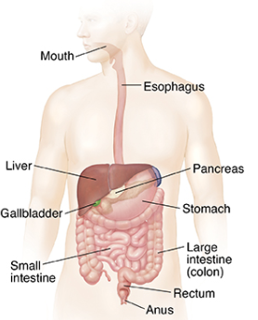
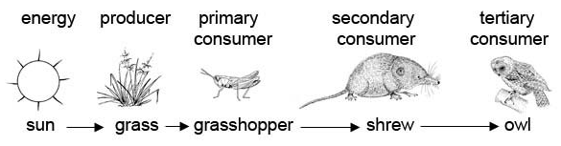

Slide 11
Block 2
Physics
Sound

Slide 12
Year 4 Block 2 Sound Big Idea(s): P1, P3 | Retrieval vocab: absorption, conductor, energy, insulator, particle, wave New vocab: vibration, percussion instrument, wind instrument, string instrument, frequency, volume, pitch, transverse wave, longitudinal wave, medium, vacuum
Week 1 | Know that science is a way to understand our world by carefully thinking about it and testing our guesses with observations and experiments (retrieval) Know that energy comes in different forms and can be neither created nor destroyed, only changed from one form to another (retrieval) Know that sound is generated when an object vibrates; some of the energy from the vibrating object is transferred to the air, making the air particles move
Week 2 | Know that sound is a form of energy that transfers in a longitudinal wave - like that seen in a slinky - not a transverse wave - like that seen in water ripples (see diagram below) Know that sound travels through a medium (e.g. particles in the air) and thus sounds does not travel through a vacuum which has no particles in it at all
Week 3 | Know that longitudinal sound waves are detected in the ear by humans and that the brain interprets this as the sounds we hear
Week 4 | Know that sound travels at different speeds through different objects; it travels at around 340 metres per second in air, much slower than light travels; this is why we often hear thunder after we see lightning as the light reaches our eye before the sound reaches our ears
Week 5 | Know that pitch is how high or low a sound is and that this is determined by how many vibrations per second are being made by the vibrating object; the number of vibrations per second is called frequency Know that volume is how loud or quiet a sound is and that this is determined by the amount of energy in the wave (e.g. from how hard or soft a percussion instrument is hit) Know that the volume of a sound is quieter if the listener is further away from the object
Week 6 | Know that there are many kinds of jobs as a scientist including communicator scientist, teacher scientist, technician scientist, explorer scientist, entrepreneur scientist, regulator scientist, investigator scientist and developer scientist Know that investigator scientists to make connections between different areas of science Know that developer scientists find new uses for scientific discoveries that other people hadn’t thought of
Notes:
Suggested number of sessions on each point to be added

Slide 13
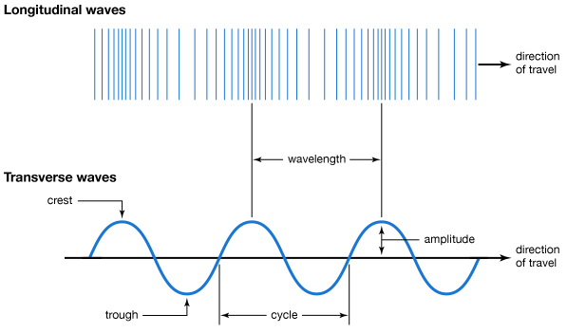
Sound
Light

Slide 14
Block 3
Physics
Electricity

Slide 15
Year 4 Block 3 Electricity Big Idea(s): P1, P3, C2 | Retrieval vocab: absorption, conductor, energy, insulator, wave New vocab: particle, vibration, percussion instrument, wind instrument, string instrument, frequency, volume, pitch, transverse wave, longitudinal wave, medium, vacuum
Week 1 (retrieval) | Know that science is a way to understand our world by carefully thinking about it and testing our guesses with observations and experiments Know that an object is made from/of a material Know that metal is a material from which objects can be made. Know that matter (stuff) is made from tiny building blocks Know that energy comes in different forms and can be neither created nor destroyed, only changed from one form to another
Week 2 | Know that electrical energy is one of many forms of energy Know that static electricity is an imbalance of charged particles on a material; it does not operate by flowing around a complete circuit Know that current electricity is the flow of charged particles called electrons around a circuit Know that current electricity is the form of electricity that we use in our lives in lights, computers, televisions, etc
Week 3 | Know that electrical current flows well through some materials, called electrical conductors, and poorly through other materials, called electrical insulators Know that conductors have free electrons (tiny, negatively charged particles) and that when electrical current flows around a conductor the electrons move Know that electrical conductivity (how well a material conducts electricity) is an example of a property Know that metals are good electrical conductors
Notes:
Suggested number of sessions on each point to be added

Slide 16
Week 4 | Know that a chemical reaction inside a cell produces the charged particles that can flow around a circuit Know that more than one cell lined up to work together is called a battery Cells, batteries and the mains are all sources of electrical energy Know that electrical current can flow if there is a complete circuit Know that wires – which contain a conductor inside them, usually made of metal – can allow electrical current to flow around a circuit Know that when electrical current flows through a circuit components within that circuit – such as buzzers which make a noise and bulbs which emit light – begin to work Know that a switch functions by completing or breaking a complete circuit Know how to construct a simple circuit using components Know that exposure to high levels of electrical current can be dangerous
Week 5
Week 6 | Know that Michael Faraday was a scientist who studied electricity Know that he invented the electric motor and showed that the movement of a magnet could create electricity, which is the reason we can generate electricity to power our world Know that he is considered “the father of electricity”

Slide 17
Block 4
Chemistry
Solids, Liquids and Gases

Slide 18
Year 4 Block 4 Solids, Liquids and Gases Big Idea(s): P2 | Retrieval vocab: absorption, dissolving, energy, evaporation, freezing, matter, melting, particle, temperature, ice, water, solid New vocab: bond, condensation, evaporation, reversible, boiling point, melting point, liquid, gas, thermometer, water cycle, continuous precipitation, transpiration, surface runoff process, sublimation
Week 1 (retrieval) | Know that science is a way to understand our world by carefully thinking about it and testing our guesses with observations and experiments Know that an object is made from/of a material Know that materials can be hard, soft, strong, weak, absorbent, heavy, light, solid and runny, smooth and rough; these descriptions denote the properties of a material Know that matter (stuff) is made from tiny building blocks
Week 2 | Know that things are composed of a matter commonly in one of three states of matter: solid, liquid or gas Know that things are made of particles (tiny building blocks) and that these are organized differently in different states (see diagram below)
Week 3 | Know that materials can change state when temperature changes Know that there are bonds between the particles (building blocks) in a solid; as temperature increases, these bonds are somewhat overcome as the particles absorb energy and solids can change into liquids; with a further increase in temperature, the particles become even more energetic and the bonds are overcome entirely so the liquid changes into a gas Know that when solids turn into liquids, this is called melting and that the reverse process is called freezing (see diagram below) Know that when liquids turn into gases, this is called evaporation and that the reverse process is called condensation (see diagram below) Know that when a solid turns into a gas without passing through the liquid state, this is called sublimation (see diagram below) Know that the melting point of water is 0º C and that the boiling point of water is 100º C
Week 4
Notes:
Suggested number of sessions on each point to be added

Slide 19
Week 5 | Know that water flows around our world in a continuous process called the water cycle (see diagram below) Know that, along with evaporation, water on the Earth’s surface moves to the air in a process called transpiration in which water turns into water vapour (gas) on the surface of leaves on plants Know that rain condenses in clouds and falls to earth as rain, snow or hail in a process called precipitation Know that water flows across the land in rivers and streams in a process called surface run-off and under the ground as groundwater
Week 6

Slide 20
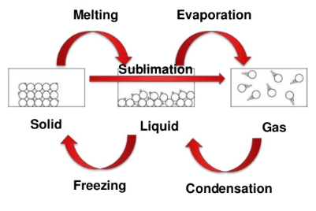
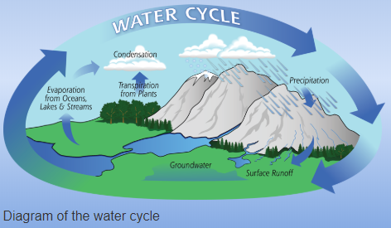

Slide 21
Block 5
Biology
Living Things and Their Habitats

Slide 22
Year 4 Block 5 Plants and Animals Big Idea(s): B1, B2, B3 | Retrieval vocab: decay, energy, habitat, freezing plant, structure, herbivore, carnivore, omnivore, microhabitat, environment, reproduction, vertebrate New vocab: kingdom, classification key, species, fungi, bacteria, climate change, characteristics, offspring, extinction, pollution
Week 1 (retrieval) | Know that science is a way to understand our world by carefully thinking about it and testing our guesses with observations and experiments Know that living things move, grow, consume nutrients and reproduce; that dead things use to do these things, but no longer do; and that things that never lived have never done these things. Know that polar bears are an example of an animal adapted to its environment – thick fur for warmth and oily paw pads to ensure that they don’t freeze to the ice. Know that a trout is an example of fish, a frog is an example of an amphibian; a lizard is an example of a reptile; a robin is an example of a bird; a rabbit and a human are examples of a mammal
Week 2 (retrieval) | Know that herbivorous animals eats plants; a carnivorous animal eats other animals; omnivorous animals eat both animals and plants Know that a cat is an example of a carnivore; that a rabbit is an example of a herbivore; know that many humans are examples of omnivores (though not vegetarians) Know that fish, amphibians, reptiles, birds and mammals are similar in that they have internal skeletons and organs; these are known as vertebrates, which means they are animals that have a backbone
Week 3 (retrieval) | Know that fish are different to other animals in having gills so that they can breathe underwater and have scaly skin Know that amphibians are different to other animals in that they begin their lives with gills but then develop lungs and breath on land Know that reptiles are different to other animals in that they breath air and have scaly skin Know that birds are different to other animals in that they have feathers and wings Know that mammals are different to other animals in that they have fur/hair and they feed milk to their young Know a rose bush, grass, dandelion by sight Know an ash tree, birch tree and conifer tree by sight
Notes:
Suggested number of sessions on each point to be added

Slide 23
Week 4 | Know that animals can be grouped based on their physical characteristics (e.g. vertebrates and invertebrates) and based on their behavior (e.g. herbivores, carnivores and omnivores)
Week 5 | Know that living things are divided into kingdoms: the animal kingdom, plants, fungi, bacteria, and single-celled organisms
Week 6 | Know that a species is a group of living things have many similarities that can reproduce together produce offspring

Slide 24
Block 6
Biology
Living Things and Their Habitats

Slide 25
Year 4 Block 6 Plants and Animals Big Idea(s): B1, B2, B3 | Retrieval vocab: decay, energy, habitat, freezing plant, structure, herbivore, carnivore, omnivore, microhabitat, environment, reproduction, vertebrate New vocab: kingdom, classification key, species, fungi, bacteria, climate change, characteristics, offspring, extinction, pollution
Week 1 | Know that a classification key uses questions to sort and identify different living things (see diagram below) Know how to use a classification key to identify living things
Week 2
Week 3 | Know how to create a classification key to sort plants on the school premises
Week 4
Week 5 | Know that changes to the environment can make it more difficult for living things to survive and reproduce; in extreme cases this leads to extinction, where an entire species dies Know that human activity – such as climate change caused by pollution - can change the environment for many living things, endangering their existence Know that many species of living things have already been made extinct as a result of human activity Know that the polar bear is a famous example of climate change endangering the existence of a species; as the climate changes and gets warmer, the sea ice on which polar bears live reduces in amount making it harder for them to survive and reproduce
Week 6 | Know that Carl Linnaeus was a famous scientist who studied life and created a system for sorting living things into different groups Know that the concept of species and kingdoms (such as the animal kingdom or the plant kingdom) was his invention, and that all living things are given a name that uses his method of classification
Notes:
Suggested number of sessions on each point to be added

Slide 26
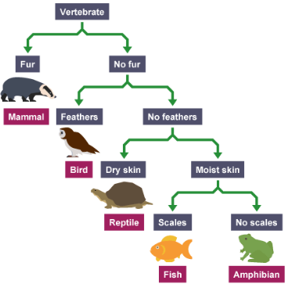

Slide 27
Working Scientifically:
Enquiries

Slide 28
Topic | Small Question | Enquiry | Big Idea(s) | Enquiry Type | Working Scientifically Skill
Animals Including Humans | How can we know things about a dinosaur when they have been extinct for 65 million years? | Following learning about human teeth, chn use information and pictures of different teeth from dinosaurs to try to work out what they might have eaten, justifying their answers. (Use language of carnivore, omnivore and herbivore.) | B3: The different kinds of life, animals, plants and microorganisms, have evolved over millions of generations into different forms in order to survive in the environments in which they live. (e.g. the right teeth for their food.) | finding out using secondary sources grouping and classification | Sc4/1.4, Sc4/1.7, Sc4/1.8, Sc4/1.9
Sound | How do instruments make different sounds? | Chn to make a basic guitar or flute with different notes possible to show how different vibrations make notes of different pitch. | P3: Energy, which cannot be created or destroyed, comes in many different forms and tends to move away from objects that have lots of it. (Sound is one form of energy.) | noticing patterns | Sc4/1.1, Sc4/1.2, Sc4/1.3, Sc4/1.4, Sc4/1.5, Sc4/1.6, Sc4/1.7, Sc4/1.9
Electricity | Does electricity flow easily through all objects? | Chn to create a small circuit to test whether objects are conductors or insulators (e.g. circuit with bulb which lights when a gap in the circuit is bridged.) | P3: Energy, which cannot be created or destroyed, comes in many different forms and tends to move away from objects that have lots of it. (Electrical energy in this case ‘moves away from’ the battery.) | grouping and classification comparative test | Sc4/1.1, Sc4/1.2, Sc4/1.3, Sc4/1.4, Sc4/1.5, Sc4/1.6 (enquiry write up), Sc4/1.7, Sc4/1.8, Sc4/1.9
Solids, Liquids and Gases | Does water always melt at the same speed? | Chn to observe and record as ice melts in different conditions (e.g. outside vs radiator, wrapped in insulation vs not) | C3: Matter can change if the arrangement of the building blocks, of which is is made, changes. | observing over time comparative test (beginning to include elements of fair testing) | Sc4/1.1, Sc4/1.2, Sc4/1.3, Sc4/1.4, Sc4/1.5, Sc4/1.6 (enquiry write up), Sc4/1.7, Sc4/1.8, Sc4/1.9
Living Things and Their Habitats | Are some animals more alike than others? | Children to use pictures to put animals into groups in different ways (e.g. where they live, what they eat, how they move, how many legs, etc) moving on to using keys to differentiate between closely related animals. | B2: Living things on Earth come in a huge variety of different forms that are all related because they all came from the same starting point 4.5 billion years ago. | grouping and classification | Sc4/1.4, Sc4/1.7, Sc4/1.8
Living Things and Their Habitats | Are some animals more alike than others? | Children to use descriptions to put animals into groups in different ways (e.g. where they live, what they eat, how they move, how many legs, etc) moving on to using keys to differentiate between closely related animals. | B2: Living things on Earth come in a huge variety of different forms that are all related because they all came from the same starting point 4.5 billion years ago. | grouping and classification | Sc4/1.4, Sc4/1.7, Sc4/1.8
Notes:
Links to WS points in final column

