Slide 1

Computing Curriculum
Supported with resources from Teach Computing

Slide 2
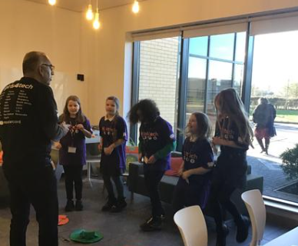
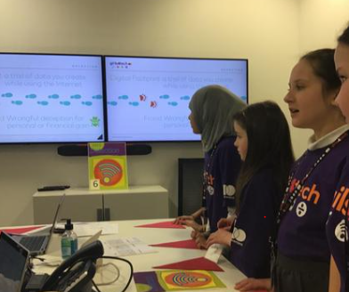
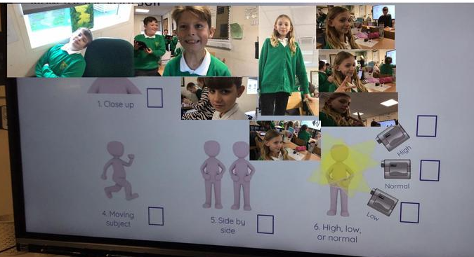

Slide 3
Whole-school definition of Computing
Computing is the process of using computer technology to complete a given goal-oriented task.

Slide 4
Purpose of study
A high-quality computing education equips pupils to use computational thinking and
creativity to understand and change the world. Computing has deep links with
mathematics, science, and design and technology, and provides insights into both natural
and artificial systems. The core of computing is computer science, in which pupils are
taught the principles of information and computation, how digital systems work, and how to
put this knowledge to use through programming. Building on this knowledge and
understanding, pupils are equipped to use information technology to create programs,
systems and a range of content. Computing also ensures that pupils become digitally
literate – able to use, and express themselves and develop their ideas through, information
and communication technology – at a level suitable for the future workplace and as active
participants in a digital world.
Aims
The national curriculum for computing aims to ensure that all pupils:
can understand and apply the fundamental principles and concepts of computer science, including abstraction, logic, algorithms and data representation
can analyse problems in computational terms, and have repeated practical experience of writing computer programs in order to solve such problems
can evaluate and apply information technology, including new or unfamiliar technologies, analytically to solve problems
are responsible, competent, confident and creative users of information and communication technology.

Slide 5
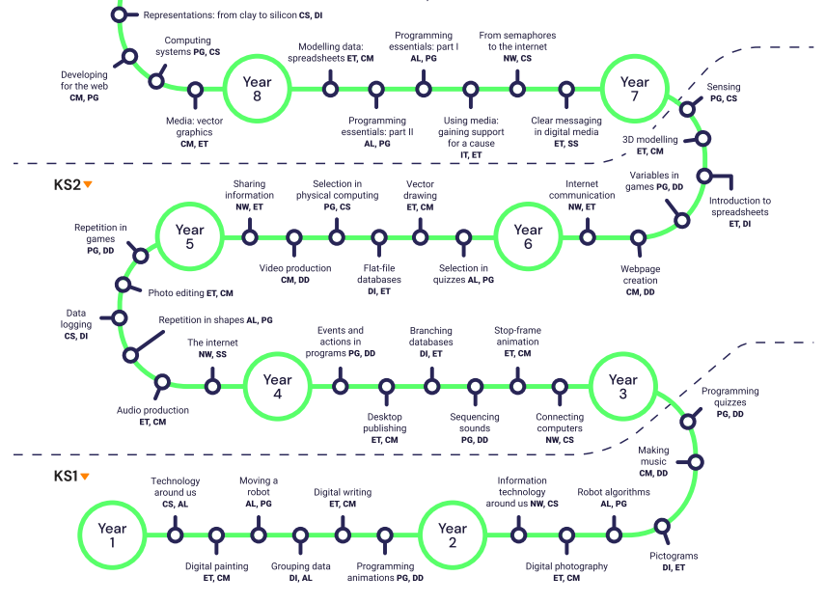
Overview - LTP

Slide 6
Taxonomy
Abbreviation | Strand | Description
NW | Networks | Understand how networks can be used to retrieve and share information and come with associated risks
CM | Creating Media | Select and create a range of media including text, images, sounds and video.
DI | Data & Information | How is data stored, organised and used to represent real world artefacts and scenarios
DD | Design & Development | The activities involved in planning, creating and evaluating computing artefacts
CS | Computing Systems | What is a computer, how do its constituent parts function together as a whole
IT | Impact of Technology | How individuals, systems and society as a whole interact with computer systems
AL | Algorithms | Being able to comprehend, design, create and evaluate algorithms
PG | Programming | Creating software to allow computers to solve problems
ET | Effective Use of tools | Use software tools to support computing work
SS | Safety & Security | Understanding risks when using technology and how to protect individuals and systems

Slide 7
National Curriculum
Key stage 1
Pupils should be taught to:
understand what algorithms are; how they are implemented as programs on digital devices; and that programs execute by following precise and unambiguous instructions
create and debug simple programs
use logical reasoning to predict the behaviour of simple programs
use technology purposefully to create, organise, store, manipulate and retrieve digital content
recognise common uses of information technology beyond school
use technology safely and respectfully, keeping personal information private; identify where to go for help and support when they have concerns about content or contact on the internet or other online technologies.

Slide 8
Year 1

Slide 9
Y1 Overview
Autumn | Computing systems and networks – Technology around us | Creating media - Digital painting
Spring | Programming A - Moving a robot | Data & information – Grouping Data
Summer | Creating Media- Digital Writing | Programming B – Programming animations

Slide 10
Key Vocabulary- Year 1
Year 1
Computing systems and networks - Technology around us | Creating media - Digital painting | Creating media - Digital writing
technology, computer, mouse, trackpad, keyboard, screen, double-click, typing. | paint program, tool, paintbrush, erase, fill, undo, shape tools, line tool, fill tool, undo tool, colour, brush style, brush size, pictures, painting, computers | word processor, keyboard, keys, letters, type, numbers, space, backspace, text cursor, capital letters, toolbar, bold, italic, underline, mouse, select, font, undo, redo, format, compare, typing, writing.
Data and information – Grouping | Programming A - Moving a robot | Programming B – Programming animations
object, label, group, search, image, property, colour, size, shape, value, data set, more, less, most, fewest, least, the same | Bee-Bot, forwards, backwards, turn, clear, go, commands, instructions, directions, left, right, route, plan, algorithm, program. | ScratchJr, command, sprite, compare, programming, area, block, joining, start, run, program, background, delete, reset, algorithm, predict, effect, change, value, instructions, design.

Slide 11
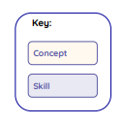
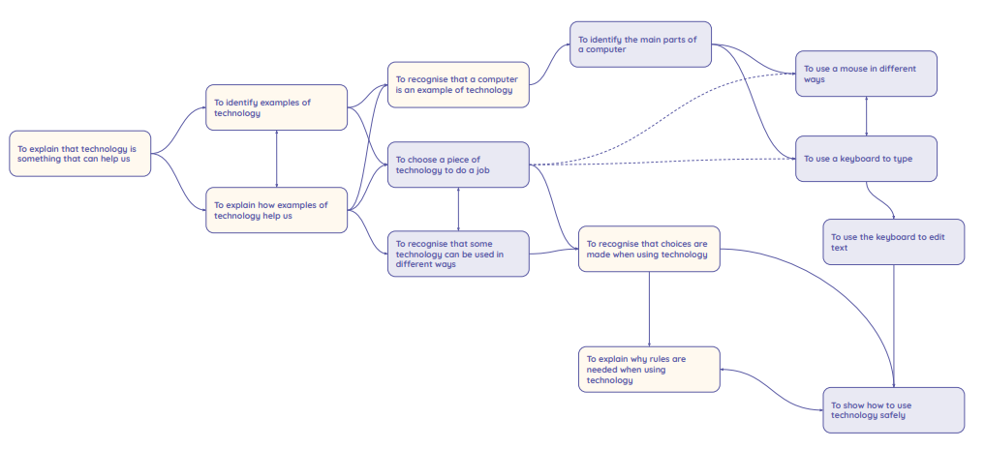
Unit 1: Computing systems and networks – Technology around us
Learners will develop their understanding of technology and how it can help them in their everyday lives. They will start to become familiar with the different components of a computer by developing their keyboard and mouse skills. Learners will also consider how to use technology responsibly.

Slide 12
Lesson | Brief overview | Learning objectives
1 Technology around us | Learners will become familiar with the term ‘technology’. They will classify what is and what is not technology in their school and/or classroom. Learners will demonstrate their understanding of how technology helps us in different ways. | To identify technology I can explain technology as something that helps us I can locate examples of technology in the classroom I can explain how these technology examples help us
2 Using technology | Learners will get to know the main parts of a desktop or laptop computer. They will practise turning on and logging in to a computer. The learners will apply their knowledge of the different parts of a computer, to complete a mouse-based task. | To identify a computer and its main parts I can name the main parts of a computer I can switch on and log into a computer I can use a mouse to click and drag
3 Developing mouse skills | Learners will be building on the mouse skills they were introduced to in Lesson 2. Learners will review images of a computer to explain what each part does. They will develop an understanding that different computers use different mice, but they perform the same function. They will use the mouse to open a program and create a simple picture. | To use a mouse in different ways I can use a mouse to open a program I can click and drag to make objects on a screen I can use a mouse to create a picture
4 Using a computer keyboard | Learners will begin to use the computer keyboard for a purpose. They should understand that writing on a keyboard is called typing and will begin to demonstrate their ability to write their name. Learners will then save their work using the save icon and understand that this icon is used in lots of different programs. | To use a keyboard to type on a computer I can say what a keyboard is for I can type my name on a computer I can save my work to a file
5 Developing keyboard skills | Learners will begin by opening a file they have previously created. They will demonstrate their ability to use a keyboard to edit text, by writing a sentence and then deleting letters. They will also use the keyboard arrow keys to move the text cursor in their textbox. | To use the keyboard to edit text I can open my work from a file I can use the arrow keys to move the cursor I can delete letters
6 Using a computer responsibly | Learners will be introduced to the concept of using computers safely, within the context of a school setting. They will explore why we have rules in school and how those rules help us, and then apply this understanding to rules needed for using computer technology safely. | To create rules for using technology responsibly I can identify rules to keep us safe and healthy when we are using technology in and beyond the home I can give examples of some of these rules I can discuss how we benefit from these rules

Slide 13
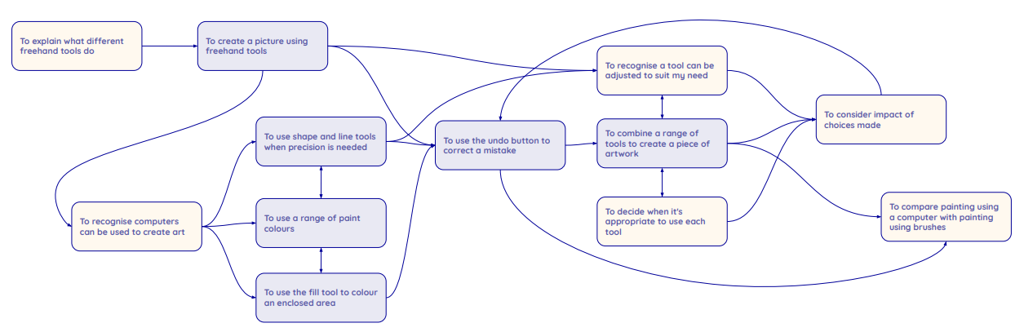
Unit 2: Creating Media – Digital Painting
Prior Learning
Learners should be familiar with:
How to switch their device on
Usernames
Passwords
Learners will develop their understanding of a range of tools used for digital painting. They then use these tools to create their own digital paintings, while gaining inspiration from a range of artists’ work. The unit concludes with learners considering their preferences when painting with and without the use of digital devices.

Slide 14
Lesson | Brief overview | Learning objectives
1 How can we paint using computers? | This lesson introduces learners to the freehand tools available for digital painting. | To describe what different freehand tools do I can make marks on a screen and explain which tools I used I can draw lines on a screen and explain which tools I used I can use the paint tools to draw a picture
2 Using shape and lines | This lesson introduces learners to the line and shape tools and revisits the fill and undo tools used for digital painting. Learners create their own digital painting in the style of an artist. | To use the shape tool and the line tools I can make marks with the square and line tools I can use the shape and line tools effectively I can use the shape and line tools to recreate the work of an artist
3 Making careful choices | This lesson introduces learners to a range of shape tools, allowing them to create a painting in the style of an artist. | To make careful choices when painting a digital picture I can choose appropriate shapes I can make appropriate colour choices I can create a picture in the style of an artist
4 Why did I choose that? | This lesson increases learners’ understanding of the available paint tools and encourages them to select the best tools to create a digital painting in the style of Wassily Kandinsky. | To explain why I chose the tools I used I can explain that different paint tools do different jobs I can choose appropriate paint tools and colours to recreate the work of an artist I can say which tools were helpful and why
5 Painting all by myself | Learners select appropriate colours, brush sizes, and brush tools to independently create their own image in the style of an artist. | To use a computer on my own to paint a picture I can make dots of colour on the page I can change the colour and brush sizes I can use dots of colour to create a picture in the style of an artist on my own
6 Comparing computer art and painting | Learners compare their preferences when creating paintings on computers and on paper. | To compare painting a picture on a computer and on paper I can explain that pictures can be made in lots of different ways I can spot the differences between painting on a computer and on paper I can say whether I prefer painting using a computer or using paper

Slide 15
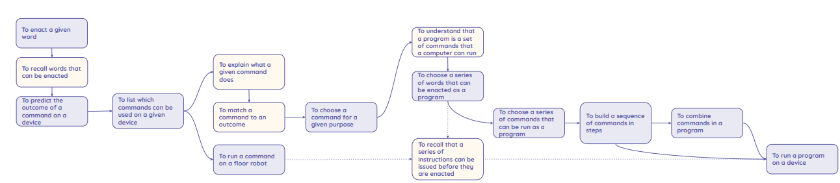
Unit 3: Programming – Moving a Robot
Learners will Learners will be introduced to early programming concepts. Learners will explore using individual commands, both with other learners and as part of a computer program. They will identify what each command for the floor robot does, and use that knowledge to start predicting the outcome of programs. The unit is paced to ensure time is spent on all aspects of programming, and builds knowledge in a structured manner. Learners are also introduced to the early stages of program design through the introduction of algorithms.

Slide 16
Lesson | Brief overview | Learning objectives
1 Buttons | Learners will be introduced to floor robots. They will talk about what the buttons on a floor robot might do and then try the buttons out. They will spend time linking an outcome to a button press. Learners will consider the direction command buttons, as well as the ‘clear memory’ and ‘run program’ buttons. | To explain what a given command will do I can predict the outcome of a command on a device I can match a command to an outcome I can run a command on a device
2 Directions | Learners will think about the language used to give directions and how precise it needs to be. They will also work with a partner to give and follow instructions. These real-world activities should, at suitable points during this lesson, be related to the floor robot introduced in Lesson 1. | To act out a given word I can follow an instruction I can recall words that can be acted out I can give directions
3 Forwards and backwards | Learners will focus on programming the floor robot to move forwards and backwards. They will see that the robot moves forwards and backwards a fixed distance. This highlights the idea that robots follow a clear, fixed command in a precise and repeatable way. Learners will think about starting the robot from the same place each time. Using the same starting position with fixed commands will allow learners to predict what a program will do. Note: This lesson focuses specifically on forward and backward movement only. This is to ensure that learners are developing a depth of knowledge in the concepts surrounding programming, as well as developing their ability to make the robot move. The success criteria for this lesson highlight this and ensure that the learners’ knowledge is built in a suitably paced way. | To combine ‘forwards’ and ‘backwards’ commands to make a sequence I can compare forward and backward movements I can start a sequence from the same place I can predict the outcome of a sequence involving ‘forwards’ and ‘backwards’ commands
4 Four directions | Learners will use ‘left turn’ and ‘right turn’ commands along with ‘forwards’ and ‘backwards’ commands. Doing this will allow learners to develop slightly more complex programs. Learners will create their programs in this lesson through trial and error, before moving on to planning out their programs in Lesson 5. In Activity 3, learners will predict where given programs will move the robot to. Learners will make their predictions by looking at the commands and matching the program steps to movements. | To combine four direction commands to make sequences I can compare left and right turns I can experiment with ‘turn’ and ‘move’ commands to move a robot I can predict the outcome of a sequence involving up to four commands

Slide 17
Lesson | Brief overview | Learning objectives
5 Getting there | Learners will decide what their program will do. They will then create their program and test it on the robot. Where needed, learners will also debug their program. | To plan a simple program I can explain what my program should do I can choose the order of commands in a sequence I can debug my program
6 Routes | Learners will be encouraged to plan routes around a mat before they start to write programs for those routes. The activities in this lesson also introduce the concept of there being more than one way to solve a problem. This concept is valid for a lot of programming activities: the same outcome can be achieved through a number of different approaches, and there is not necessarily a ‘right’ approach. The lesson also introduces the idea of program design, where learners need to plan what they want their program to achieve before they start programming. | To find more than one solution to a problem I can identify several possible solutions I can plan two programs I can use two different programs to get to the same place

