Slide 1

Music Curriculum

Slide 2




Key resources to support our curriculum
For STPs and lesson-by-lesson detail/ support
For listening starters & additional lessons

Slide 3
Whole-school definition of Music
Music is an art of sound in time that expresses ideas and emotions through the building blocks of music.

Slide 4

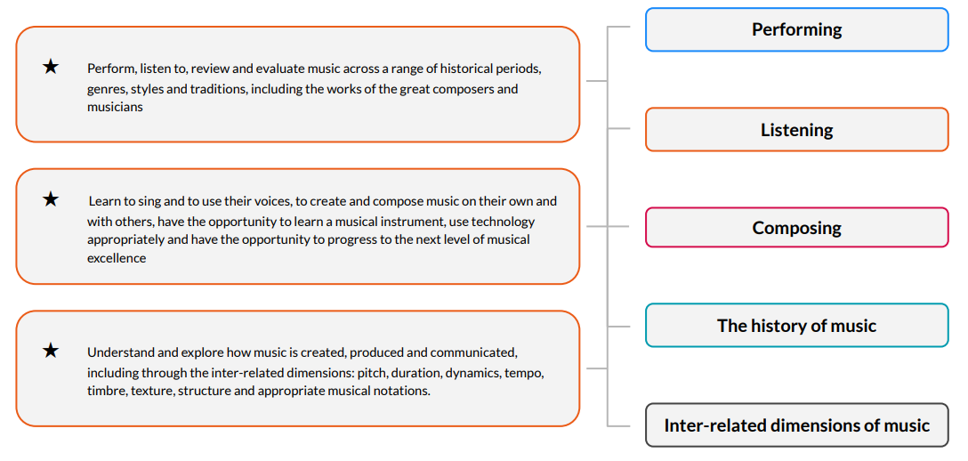
The ‘big ideas’ of our curriculum

Slide 5


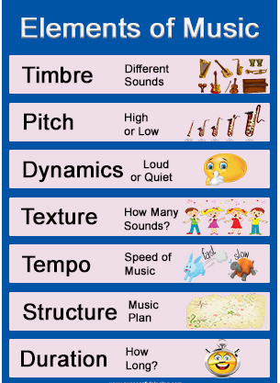
Musical elements / inter-related dimensions
Appropriate musical notation
Notes:
AKA- Key Concepts – to add onto MTPs with relevant icons

Slide 6
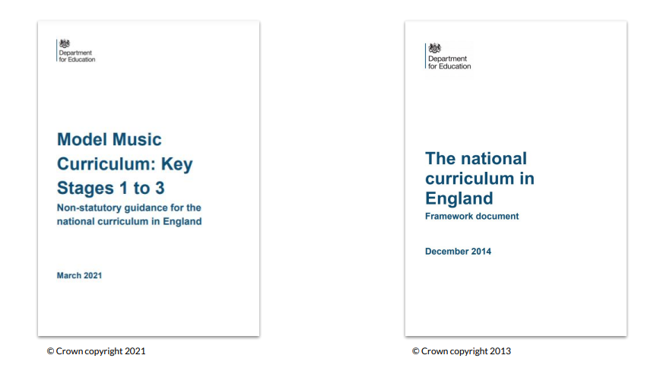

Notes:
Our curriculum is aligns with these key documents.

Slide 7
Purpose of study
Music is a universal language that embodies one of the highest forms of creativity. A high-quality music education should engage and inspire pupils to develop a love of music and their talent as musicians, and so increase their self-confidence, creativity and sense of achievement. As pupils progress, they should develop a critical engagement with music, allowing them to compose, and to listen with discrimination to the best in the musical canon.
Aims
The national curriculum for music aims to ensure that all pupils:
perform, listen to, review and evaluate music across a range of historical periods, genres, styles and traditions, including the works of the great composers and musicians
learn to sing and to use their voices, to create and compose music on their own and with others, have the opportunity to learn a musical instrument, use technology appropriately and have the opportunity to progress to the next level of musical excellence
understand and explore how music is created, produced and communicated, including through the interrelated dimensions: pitch, duration, dynamics, tempo, timbre, texture, structure and appropriate musical notations
Notes:
Add EYFS Milestones

Slide 8
Overview – LTP 2024-2025
 | Autumn 1 | Autumn 2 | Spring 1 | Spring 2 | Summer 1 | Summer 2
Preschool | Let’s be Friends | Travel and Movement | This is Me | Animal Tea Party | I’ve got Feelings | Let’s Jam
EYFS | Exploring Sound | Music & Movement | Transport | Big Band | Shake my Sillies Out (Sing Up Optional Unit) | Down there under the Sea (Sing Up Optional Unit)
Year 1 | Pulse and Rhythm | Musical Vocabulary | Timbre & Rhythmic Patterns | Pitch & Tempo | The King is in the Castle (Sing Up Optional Unit) | Who Stole my Chickens and Hens? (Sing Up Optional Unit)
Year 2 | West African Call & Response songs | Orchestral Instruments | Musical Me | Myths & Legends | Minibeasts (Sing Up Optional Unit) | The Rockpool Rock (Sing Up Optional Unit)
Year 3 | Instrumental Unit 1: Tuned Percussion with RB | Ballads | Instrumental Unit 2: Ukulele with RB | Developing singing techniques | Pentatonic Melodies & composition | Traditional instruments & improvisation
Year 4 | Instrumental Unit 1: Tuned Percussion with RB | Body & tuned percussion | Instrumental Unit 2: Ukulele with RB | Changes in pitch, tempo & dynamics | Samba and carnival sounds + instruments | Adapting and Transposing Motifs
Year 5 (PPA RB teaching all) | Instrumental Unit 1: Tuned Percussion with RB | Composition notation | Instrumental Unit 2: Ukulele with RB | Blues | South & West Africa | Composition to represent the festival of colour
Year 6 | Dynamics pitch & texture | Instrumental Unit 1: South Africa | Theme & Variations | Instrumental Unit 2: Caribbean | Baroque | Composing & performing a leavers’ song
Notes:
Please note that Year 1 and Year 2 units change 25-26 to reflect the content of the Ofsted Music Review: ‘Striking the right note’ (2023) Striking the right note: the music subject report - GOV.UK (www.gov.uk)
Preschool- Sing up Nursery scheme [Sing Up Music: Primary Music Curriculum Nursery | Sing Up]
EYFS- Y6 School: ‘Kapow Condensed Music Scheme’ X4 Units per year & Instrumental Scheme in KS2 X2 units per year.
EYFS & KS1 summer Term = X2 optional units from ‘Singup’.
Fun Lesson Warm Ups can be accessed here: Playlist: Lesson starters | Sing Up
Instrumental units are interchangeable for expert tuition – ukulele – See Play ukulele | Sing Up (music teacher to plan and devise sequence aligned to our progression) Class teachers (non-experts) to adhere to prescribed curriculum.
KS2 = 12 weeks expert-taught instrumental music teaching

Slide 9
Overview – LTP 2025-2026
 | Autumn 1 | Autumn 2 | Spring 1 | Spring 2 | Summer 1 | Summer 2
Preschool | Let’s be Friends | Travel and Movement | This is Me | Animal Tea Party | I’ve got Feelings | Let’s Jam
EYFS | Exploring Sound | Music & Movement | Transport | Big Band | Shake my Sillies Out (Sing Up Optional Unit) | Down there under the Sea (Sing Up Optional Unit)
Year 1 | Keeping the pulse (My favourite things) | Sound patterns (Fairytales) | Pitch (Superheroes) | Musical symbols (Under the sea) | The King is in the Castle (Sing Up Optional Unit) | Who Stole my Chickens and Hens? (Sing Up Optional Unit)
Year 2 | Call and response (Animals) | Instruments (Musical storytelling) | Structure (Myths and legends) | Pitch (Musical me) | Minibeasts (Sing Up Optional Unit) | The Rockpool Rock (Sing Up Optional Unit)
Year 3 | Instrumental Unit 1: Tuned Percussion | Ballads | Instrumental Unit 2: Ukulele | Developing singing techniques | Pentatonic Melodies & composition | Traditional instruments & improvisation
Year 4 | Instrumental Unit 1: Tuned Percussion | Body & tuned percussion | Instrumental Unit 2: Ukulele | Changes in pitch, tempo & dynamics | Samba and carnival sounds + instruments | Adapting and Transposing Motifs
Year 5 | Instrumental Unit 1: Tuned Percussion | Composition notation | Instrumental Unit 2: Ukulele | Blues | South & West Africa | Composition to represent the festival of colour
Year 6 | Instrumental Unit 1: Tuned Percussion | Dynamics pitch & texture | Instrumental Unit 2: Ukulele | Theme & Variations | Baroque | Composing & performing a leavers’ song
Notes:
Please note that Year 1 and Year 2 units change 25-26 to reflect the content of the Ofsted Music Review: ‘Striking the right note’ (2023) Striking the right note: the music subject report - GOV.UK (www.gov.uk)

Slide 10
Overview – Additional Key Composers & Classical Music to Study (For longer half terms)
 | BBC ‘10 Pieces’ Key focus for the year | Why?
Year 3 | Anna Clyne - Night Ferry (extract) | Celebrating Women / Contemporary Ocean theme – a journey of a ship struggling on a stormy sea * Link to water themes and Art opportunity
 | Mason Bates - Anthology of Fantastic Zoology – Sprite; A Bao A Qu | Each of its eleven distinctive movements conjures up a different mythical creature from Jorge Luis Borges' Book of Imaginary Beings, including the mischievous Sprite and the tower-dwelling beast, A Bao A Qu. * English/ Story time Links
Year 4 | Gustav Holst - ‘Mars’ from ‘The Planets’ | In ancient Roman religion Mars was the god of war. Holst composed this piece in anticipation of the outbreak of World War One. *Links to History – Romans
 | Edvard Grieg - In the Hall of the Mountain King from ‘Peer Gynt’ (1875) | Norwegian Folk Tale *Contrast with Beowulf in English – what might the story be to this music?/ Could explore through Dance also.
Year 5 | Hans Zimmer – Earth | A celebration of the planet we live on *Links to Science
 | Florence Price – Symphony No. 1 in E minor (3rd mvt) | In 1933 she overcame prejudice to become the first black female composer to have her work performed by a major orchestra. *Link- with English Autumn Unit ‘Young, Gifted & Black’.
Year 6 | Grażyna Bacewicz – Overture (1943) | Celebrating Women Written in the depths of World War II *Links to History
 | Benjamin Britten - ‘Storm’ Interlude from ‘Peter Grimes’ | Peter Grimes is a fisherman but the locals think of him as an outsider and don't trust him. *Contrast with ‘The Island’ / ‘The Arrival’ & Migration *Links to History & Music
Notes:
Other great pieces are available: Primary resources - KS2 / 2nd Level - BBC Teach
How might these pieces relate to our definition of music?
Music is an art of sound in time that expresses ideas and emotions through the building blocks of music.

Slide 11
Year 1

Slide 12
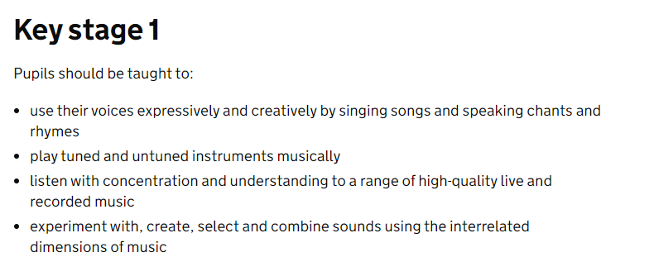
National Curriculum

Slide 13
Y1 Overview
Autumn | Pulse and Rhythm | Musical Vocabulary
Spring | Timbre & Rhythmic Patterns | Pitch & Tempo
Summer | The King is in the Castle (Sing Up Optional Unit) | Who Stole my Chickens and Hens? (Sing Up Optional Unit)
Notes:
Click on the hyperlinks for lesson detail / resources

Slide 14
Y1 Key Vocabulary
Autumn | body percussion, chant, clap, copy, drum, instrument, in time, shaker, percussion instrument, perform, play, pulse, rhythm, sing, syllables | actions, celeste, chorus, dynamics, fast, graphic score, heartbeat, high, in time, layers, low, pitch, Pulse, rhythm, slow, speed, structure, tempo, texture, timbre, thick, thin, tune, verse
Spring | bassoon, beat, body percussion, chant, clap, clarinet, compose, flute, French horn, instruments, oboe, orchestra, patterns, performance, play, plot, pulse, repeated phrases, represent, rhythm, rhythmic pattern, sound, strings, syllables, timbre, timpani, voice | accelerando, compose, fast, features, gradually, high, low, note, pattern, performance, pitch, play, rallentando, slow, sing, tempo, theme tune
Summer | Retrieve and Embed | Retrieve and Embed

Slide 15
Y1 Unit 1 Autumn 1 2024-2025 ONLY Key Knowledge: To know that rhythm means a pattern of long and short notes. To know that pulse is the regular beat that goes through music. To understand that the pulse of music can get faster or slower. To know that a piece of music can have more than one section, e.g. a verse and a chorus.
Week | Key Objective(s)
1 | Check Prior Learning objectives: Exploring Sound unit To use my voice and hands to make music.
2 | To clap and play in time to the music.
3 | To play simple rhythms on an instrument.
4 | To listen to and repeat short rhythmic patterns.
5 | To understand the difference between pulse and rhythm.
6 | *Assessment session* / Complete Short Quiz Pupils who are secure will be able to: Clap the rhythm of their name. Clap in time to music. Sing the overall shape of a melody. Play in time to music. Copy and create rhythms based on word patterns. Play on the pulse.

Slide 16
Whole School Progression

Slide 17
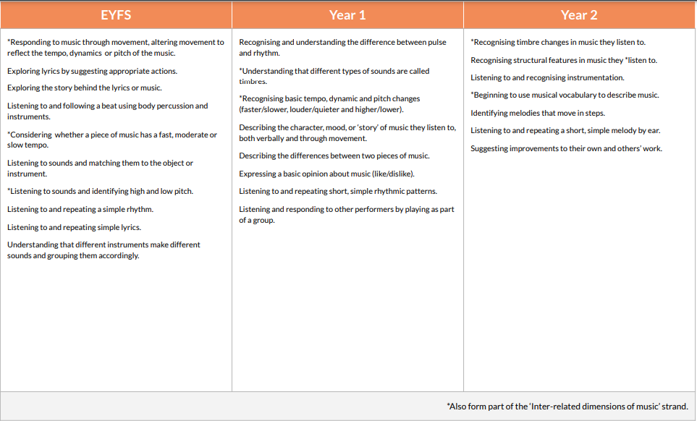

Slide 18
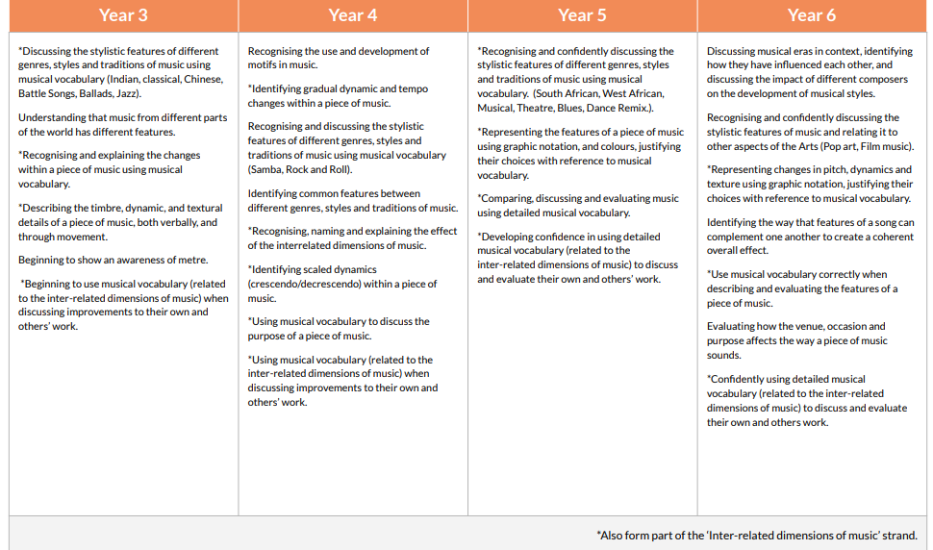

Slide 19
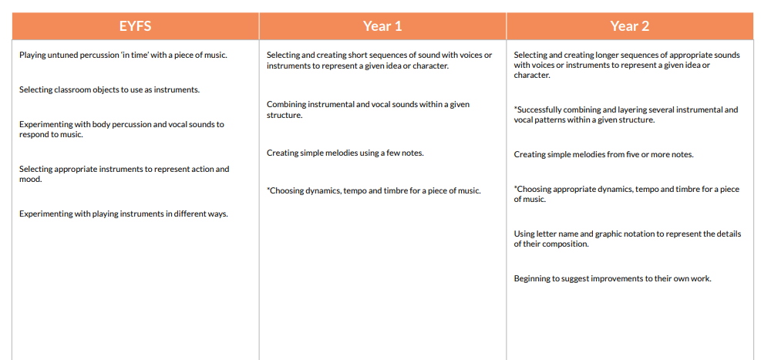

Slide 20
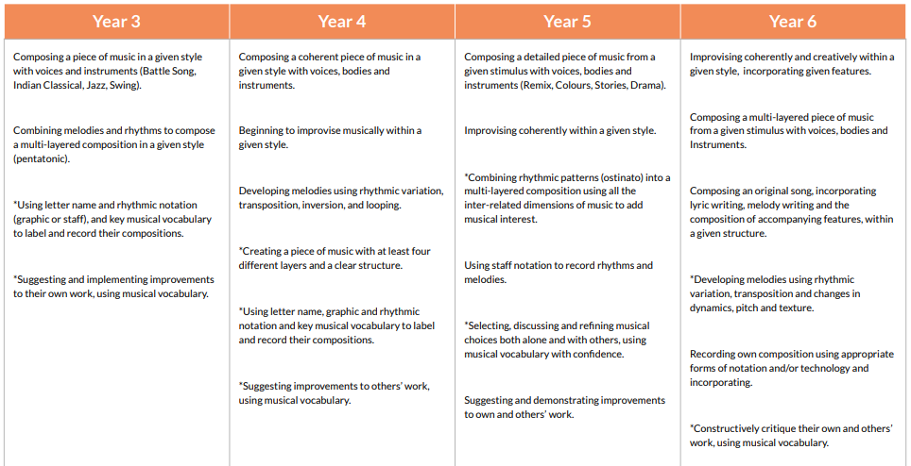

Slide 21
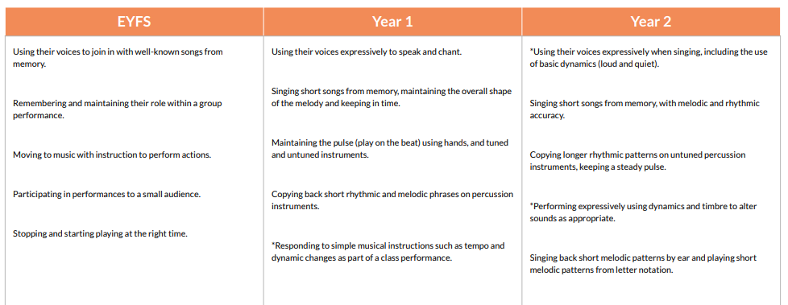


Slide 22
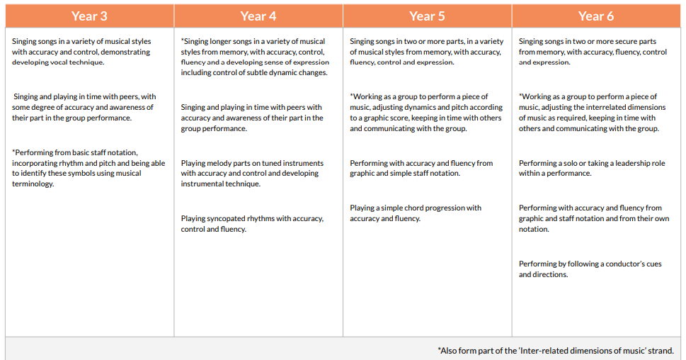

Slide 23
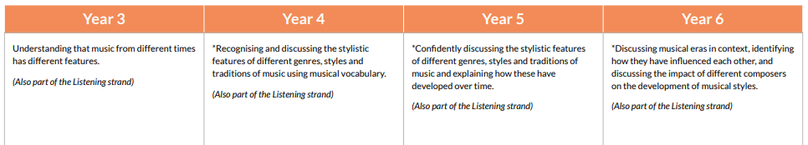


Slide 24
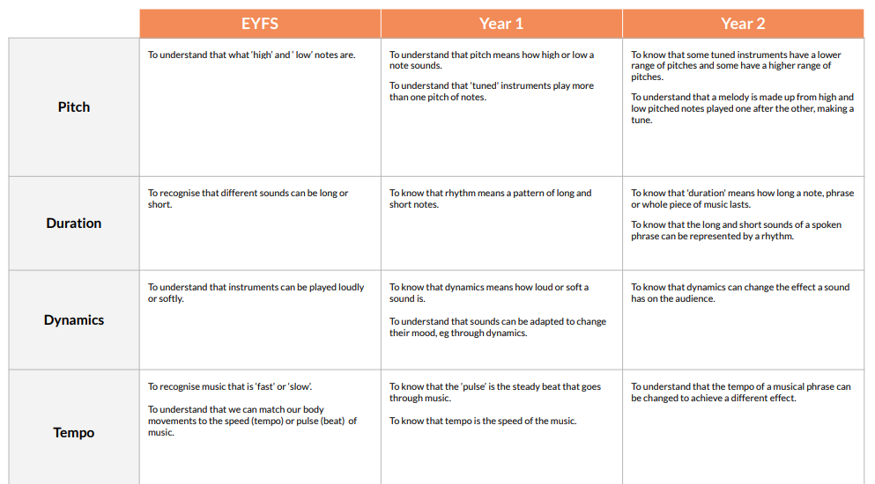


Slide 25
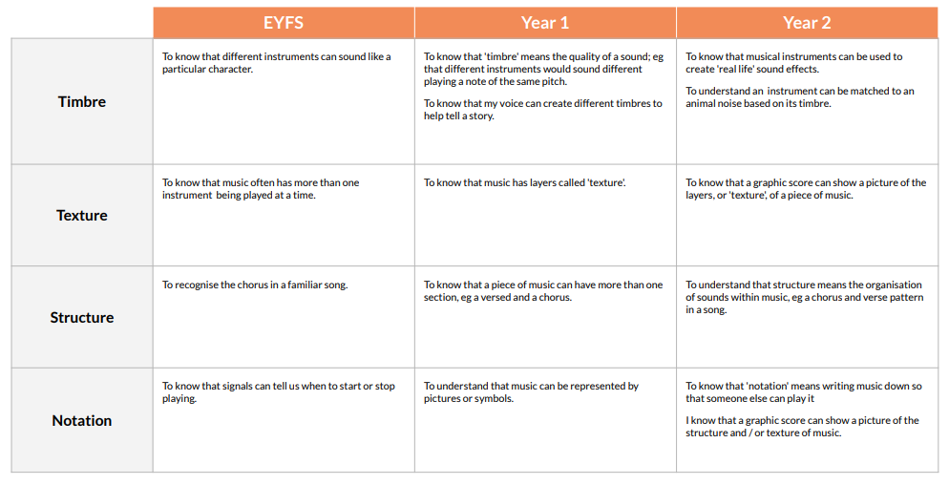

Slide 26
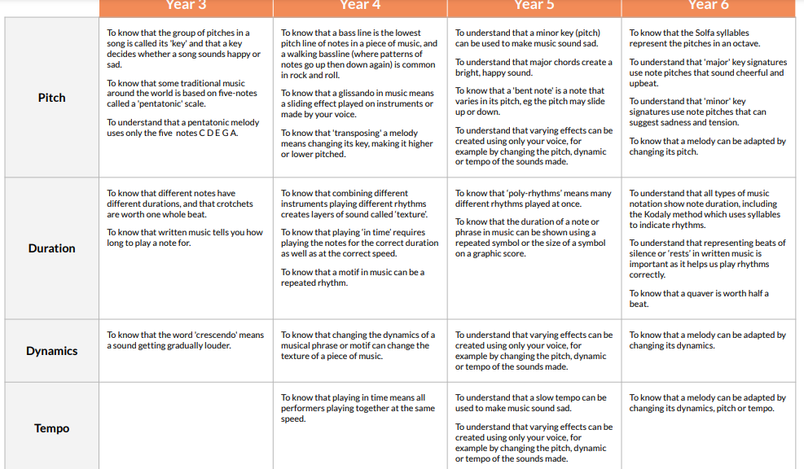

Slide 27
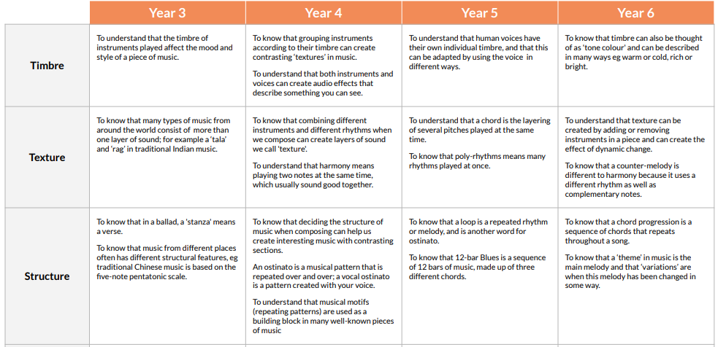

Slide 28


